Slide 1
Advocacy In Gifted
@meldernc
#onslowaig Onslow Gifted Services
Perspectives on Gifted, Information Sharing, and Strategizing
Michael Elder, Onslow County Schools

Slide 2
Who’s Here

Slide 3
What does Advocacy for Gifted Look Like to You?

Slide 4
Advocacy

Slide 5
https://advocatingcreatively.com/

Slide 6
Motivators
What motivates you to serve Gifted students?
What motivates Teachers To serve Gifted students?
What motivates Administrators To serve Gifted students?
What motivates District Leadership To Allocate funds and resources?

Slide 7
NC: A little Data & State Support
Areas Identified or Considered in State Definition (IG, AG, AR, AM, Low SES, Underachieving, Geographical Considerations, Cultural/Ethnic Diversity, EL)
Mandated Identification, Services, and Accountability
2014-2015 Data
180,477 / 1,470,127 students (12.2%)
State Funding $77,880,694 12 states reported No funding

Slide 8
Fostering District Level Support
Where is State AIG Funding being spent?
Are There local additions to the AIG budget?
Who is already on board?
How does the district hear from Parents? From Kids? How can I influence who they hear from and what they hear?
Is there an active Parent group?

Slide 9
Advocating with Administration
Typical Limiting factors for Administrators
Time- Long discussions
Understanding
Pressure for Proficiency
Other teacher needs
So, Then what Do We do?
Build a Plan
Stay Focused in Conversations
See things from Their Point of view
Seek 3rd Alternatives

Slide 10
Advocating with Administration

Slide 11
Advocating with Administration

Slide 12
Tell the Truth
Who does this sign Excite?
Who does it Freak out a little?

Slide 13
Understand Change
Communicate Verbally Over A Period Of Time
Communication needs to be clear, consistent and repeated again and again
Use verbal communication
Gain Commitment Through Two-Way Communication
Gain buy-in from everyone in the School (or as many as possible)
Implement Organizational Coaching
Emotions run high during periods of transition, and coaching for the entire organization during this time is A must
http://carolinanewswire.com/news/News.cgi?database=columns.db&command=viewone&id=279

Slide 14
Teacher Allies
What are you already finding works in building Teacher Allies?
Understanding Their work, time demands
Extensive Support
Snacks (really, snacks)
Licensure Options
Local Professional Development

Slide 15
https://www.youtube.com/watch?v=ktlTxC4QG8g

Slide 16
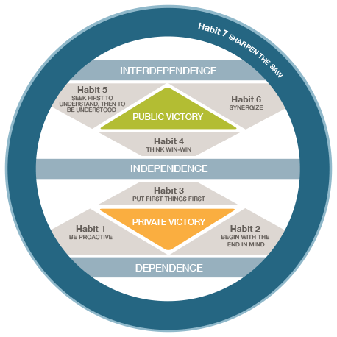
7 Habits
How do they apply to Advocacy?
Let’s Take a Look

Slide 17
Tools or Local Resources
NAGC Website : Advocacy Tool
Parent Groups- Successes/Struggles
Media: Facebook/Twitter
Annual Agreement
Cluster Suggestion
Cluster Report (Elementary)
Differentiation Strategies CheckList
Communication Logs
Budget Sharing

Slide 18
Do Cool Stuff
Rather, Do important work
Separate Interesting from Important
Involve outsiders
Projects or Products
Be visible
http://justimagine-ddoc.com/crafts/super-cool-things-to-do-with-mason-jars/

Slide 19
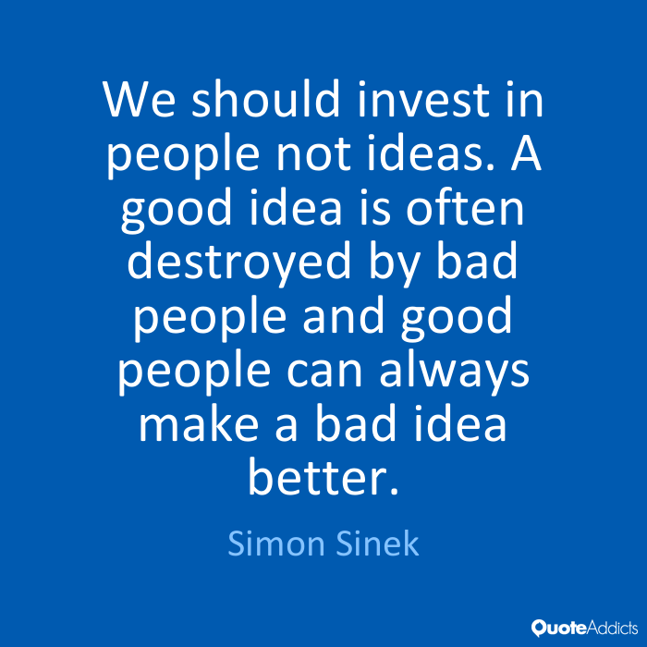

Slide 20
Michael Elder, Academic Innovation and gifted Services @meldernc Michael.elder@onslow.k12.nc.us

