Slide 1
Developing Fraction Sense
Michael Elder, Onslow County Schools
NCAGT Conference: Hern D
8:30am | March 2, 2017

Slide 2
Session Description:
"Fractions" Does that make your kids squirm? Do your gifted students get the rules, but miss the concept? Come explore Developing Fraction Sense with us using the Borenson materials.
Notes:
I do not work for Borenson
I am not selling this resource
This is just my impression of what I have seen so far in learning and using their resource

Slide 3
We are going to do some math together ☺
Mistakes and Questions are Okay
Notes:
I do not work for Borenson
I am not selling this resource
This is just my impression of what I have seen so far in learning and using their resource

Slide 4
The Kits A & B (C is coming))
Notes:
A is generally 3rd Grade
B is generally 4th Grade
C is generally 5th grade
Today we will look mostly at A and B

Slide 5
Fractions and Gifted Students But They’re Smart… Who Struggles? When? Why?

Slide 6
NAEP (4th Grade Items)
http://nces.ed.gov/NationsReportCard/nqt/link/itemlist/275256
Or
http://bit.ly/fractionsncagt

Slide 7
So Now What?

Slide 8
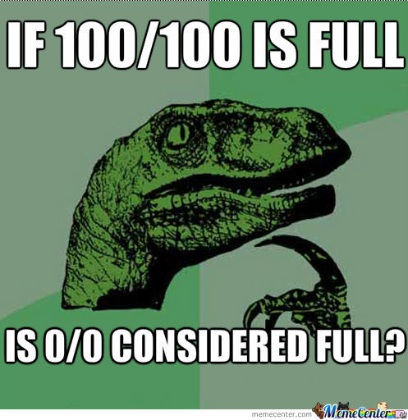
What Does It Mean to Understanding Fraction Concepts?

Slide 9
What Should Instruction Look Like?
Cecil Mercer

Slide 10
Developing Fraction Sense Level A

Slide 11
Developing Fraction Sense Level A 32 Lessons
Level A http://www.borenson.com/Products/DevelopingFractionsSenseStudentWorkbookA/tabid/1636/Default.aspx

Slide 12
Developing Fraction Sense Level A
New Concept
Frraction Blocks
Area Model
Number Line Model

Slide 13
Developing Fraction Sense Level A
Understanding Unit Fractions
Naming Fractions
Points on a Number Line
Understanding Equivalent Fractions
Recognizing Fractions Equivalent to Whole Numbers
Understanding Numerator and Denominator
Comparing Fractions
Same Denominators
Different Denominators
Same Numerators
Other Blocks as the Whole
Adding and Subtracting
Dividing by a Unit Fraction
Multiplying a Fraction by a Whole

Slide 14
Developing Fraction Sense Level A
Let’s start at the beginning because…

Slide 15
Developing Fraction Sense Level A
Let’s move to an area model
Representational

Slide 16
Developing Fraction Sense Level A
And finally to the Number Line
More Abstract

Slide 17
Developing Fraction Sense Level A
Now Let’s Jump Ahead in Time Still in Level A…
Equivalent Fractions
Next we would move to area models
Then to Number Line Models

Slide 18
Developing Fraction Sense Level B 45 Lessons
Level B Video and Samples http://www.borenson.com/Products/DevelopingFractionsSenseStudentWorkbookB/tabid/1649/Default.aspx

Slide 19
Developing Fraction Sense Level B
New Concept
Frraction Blocks
Area Model
Number Line Model

Slide 20
Developing Fraction Sense Level B
Unit Fraction
Recognizing Fractions
Comparing Fractions with Same Denominator
Fractions as Sums of Unit Fractions
Adding Fractions (Same Denominators)
Decomposing Fractions
Less Than, Equal To, More than a Whole
Benchmark of ½
Comparing Fractions with Same Numerator
Comparing Sums (Using Benchmarks)

Slide 21
Developing Fraction Sense Level B
Comparing Differences (using benchmarks)
Renaming Improper Fractions
Adding Mixed Fractions
Subtracting Mixed Fractions
Renaming Mixed Fractions as Improper
Subtracting Mixed Fractions (by Making and Exchange)
Mixed Fractions to Improper Fractions
Subtraction Using Improper Fractions
Recognizing Equivalence Using Visual Models
Comparing Fractions with Different Denominators

Slide 22
Developing Fraction Sense Level B
Forming Equivalent Fractions
Comparing Fractions with Different Denominators
Word Problems
Fractions Times a Whole
Add/Subtract Fractions with Same Denominators

Slide 23
Developing Fraction Sense Level B
Decomposing Fractions in to Sums of Fractions having the Same Denominator
Renaming Fractions

Slide 24
Developing Fraction Sense Level B
Converting Improper Fractions to Mixed Fractions

Slide 25
Developing Fraction Sense Level B
Subtracting Mixed Fractions by Making an Exchange

Slide 26
Developing Fraction Sense Level B
Equivalent Fractions Using Visual Models

Slide 27
Thank You For Sharing Your Time
@onslowaig
Michael Elder
Michael.elder@onslow..k12.nc.us
http://onslowaig.weebly.com/gifted-conference-presentations.html
@meldernc
#onslowaig

