Slide 1
Learning Contracts for Gifted Students
A Collaboration & Differentiation Concept
NCAGT Conference 2013
Heather Smith & Maria Burdette
Onslow County Schools

Slide 2

Being Gifted… a child’s perspective

Slide 3
What are Learning Contracts ?
Collaboration contracts between Classroom Teachers, AIG Specialists, and students.
Works in unison with the classroom teacher’s units of study.
Is supporting the teacher with a differentiation piece to the unit of study

Slide 4
Learning contracts should…
Provide enrichment or extend the curriculum
Challenge their abilities and encourage creativity
Provide alternative activities that address academic needs, interests, and/or learning styles of students
Help students learn to make decisions and take ownership in their learning experiences
Teach time management and organizational skills

Slide 5
Learning contracts should NOT…
Provide extra work to keep students busy when they complete classroom assignments
Become homework assignments
Be the exactly the same for every student
Feel like a punishment
Be more of the same

Slide 6
Advantages
Can be written for any curriculum area
Provide rigorous and challenging learning activities
Promote flexible grouping within the classroom
Develop student’s time-management, planning and decision making skills
Recognize individual learning needs in allowing students to skip lessons on content they already have mastered
Reduce boredom and behavior problems by minimizing repetition of mastered concepts—giving teachers time to work with students with less experience
Increases students’ independence, motivation, and class participation

Slide 7
Learning Contracts:
Integrating Language Arts
The Elephant Child
The Bat Poet
Dragonsong: A Fable for the
New Millennium

Slide 8
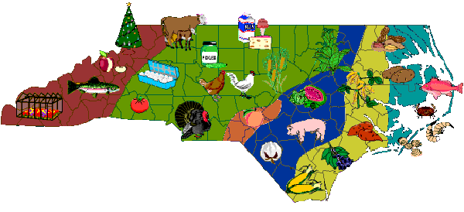
Learning Contracts:
Integrating Social Studies
5th Grade American Revolution
4th & 5th Grade Democracies of the World
4th Grade NC Commodities

Slide 9

Learning Contracts:
Integrating Math and Financial Literacy
Mini-Society Economics
Bon Voyage!

Slide 10

Learning Contracts:
Integrating Math and Science
Invasive Species: Kudzu
Ecosystems and Biomes
Endangered Species

Slide 11
Things to Consider in Planning
Essential curriculum standard(s) the contract will be addressing & how it will fit into the student’s daily schedule
Ways to provide choice in process or product
Resources the student will have access to
Criteria for success—timelines, quality work, and assessment
How will you monitor progress and provide meaningful feedback?

Slide 12
What products do you use that could be part of a learning contract?
P.R.O.B.E. notebook
Prezi

Slide 13
Response from a teacher
From: Julie
Sent: Tue 1/8/2013 3:26 PM
To: Heather
Subject: AIG presentations
Hi Heather,
I couldn't wait to email you about the two presentations that your students did today for the class. Sara and Bradley did an exceptional job of presenting to our class about North Carolina's commodities. It was evident that they worked really hard and researched their topics. Additionally, the information was presented in terms that all students could easily understand. Bradley did and exceptional job of integrating technology into his project by utilizing Prezi to share his topic. To my benefit, when I start to teach about North Carolina's commodities (in coming lessons) all of my students will have some background knowledge on that subject! I wish there was a way that all of 4th grade could see these projects. I learned so much listening and watching those two, and I can hardly wait to introduce the rest of the students to Prezi as well!
Kudos for a well planned and executed project!
Kindest Regards,
Julie

Slide 14
Q & A
Shared resources and final PowerPoint presentation can be found at http://onslowaig.weebly.com

