Slide 1
Building BIG
Edmodo Group Code:
9ps7cz
NCAGT Conference 2016
Winston-Salem, NC
Onslow County Schools
Heather Smith, AIG Specialist
Maria Burdette, AIG Specialist
Katherine Collins, Digital Learning & Technology Facilitator

Slide 2
Resources:
Join our Edmodo Group:
Group Code:
9ps7cz
Onslow County Schools AIG Website:
www.onslowaig.weebly.com
www.symbaloo.com/mix/buildingbig

Slide 3
Onslow County Schools AIG
Heather Smith, AIG Specialist
Heather.Smith@onslow.k12.nc.us
Summersill Elementary @ SSE_AIG
Bell Fork Elementary @ BFE_AIG
@h2smith80
Maria Burdette, AIG Specialist
Maria.Burdette@onslow.k12.nc.us
Jacksonville Commons Elementary
Stateside Elementary
#OnslowAIG
#OnslowDLT

Slide 4
Onslow County Schools Digital Learning & Teaching
Katherine Collins
Katherine.Collins@onslow.k12.nc.us
Clyde Erwin Elementary Magnet School
School Website http://goo.gl/trtNQu
Digital Teaching and Learning Twitter @katcollins1103

Slide 5
1:1 Initiative/Background
The OCS Tiered Technology Vision began in 2007.
Tier 1- Teacher Productivity: This gave all teachers laptops to use.
Tier 2- Classroom Productivity: Interactive boards, document camera, and digital projectors
Tier 3- Student Productivity (1:1) : Local initiative for teachers to apply for Tier 3 grants and POD (Personally Owned Devices)

Slide 6
1:1 Initiative/Background
The OCS 1:1 Initiative began the 2014-2015 school year.
1:1 Roll Out Timeline
2014-2015 Grades 7-9
2015-2016 Grades 5, and 10
2016-2017 Grades 4, 6 and 11
2017-2018 Grades 3 and 12
2018-2019 Grades K-2 Local Initiative

Slide 7
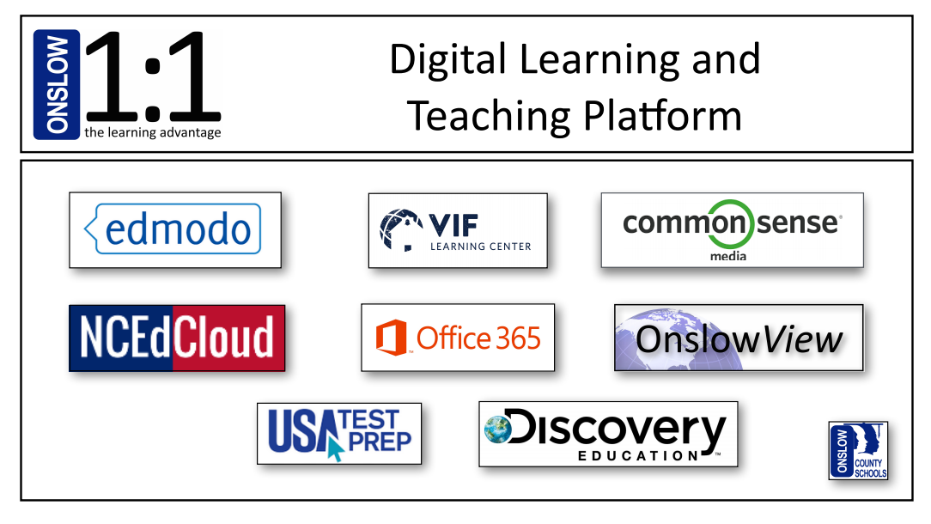
1:1 Initiative/Platform

Slide 8
1:1 Initiative/Platform
Edmodo is a LMS (learning management system) that allows for teachers to communicate and manage students’ learning through notes, polls, quizzes, assignments, Snapshots, an agenda, and apps.
A Global Gateway system that offers an integrated platform of professional development, lesson plans, resources etc… to help educators support global competence with their students.
Common Sense Media is used to support the teaching of Digital Citizenship to grades K-12.
This is our current benchmark assessment resource for ELA, math, and science.

Slide 9
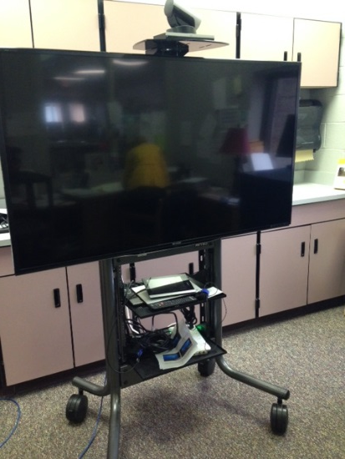
1:1 Initiative/Platform
This houses PowerSchool resources (PowerTeacher, NCEES, SchoolNet, & PowerTeacher Admin
Office 365 is available for both teachers and students and allows students to use online versions of Microsoft Office products. Students also can use OneNote, SWAY, and Mix. Sharing and Syncing are well underway in Onslow County Schools.
OnslowView allows classrooms to video conference with other schools and places with a Cisco system for virtual field trip and collaboration experiences.

Slide 10
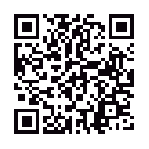
Technology Platform Alternatives
The idea behind having a platform is to have resources that target specific areas of digital learning.
Learning Management System (LMS), Formative Assessments, Video, Collaboration & Communication, etc…
The QR code takes you to a Livebinder with alternative resources.

Slide 11
Standards of Practice for Digital Learning & Teaching Environments
The purpose behind incorporating the use of a Class Notebook through Office 365 is to support the county’s technology platform and Standards of Practice. The use of Class Notebook has also made sharing, completing, and viewing assignments easy and quick.

Slide 12
Onslow County Schools AIG Elementary Services
Grades 3-5 in pull-out setting at most elementary schools
2 to 3 contacts weekly
Building BIG is an all-inclusive unit
Reading, Math, & Nonverbally Gifted
Social/Emotional Skills
4th or 5th grade

Slide 13
Building BIG Resources
Each AIG group is different.
Size
Ability levels
Interests
Social Skills
Backgrounds
Make it work for your students!

Slide 14
Building BIG
Phase 1: Engineering
Phase 2: Bridge Basics
Phase 3: Business Design
Phase 4: Construction
Phase 5: Test and Analyze

Slide 15
Phase 1: Engineering
Essential Questions:
What are civil engineers?
What skills are important in order to be successful as a civil engineer?
What is the future outlook for this career field?

Slide 16
Phase 1: Engineering
Civil Engineering
US Department of Labor
Live Science: Civil Engineering
Videos Located in OneNote & Symbaloo
What is Engineering?
What Do Civil Engineers Do?
Career Choices: Civil Engineers
CCSS.ELA-LITERACY.RI.5.9 Integrate information from several texts on the same topic in order to write or speak about the subject knowledgeably.

Slide 17
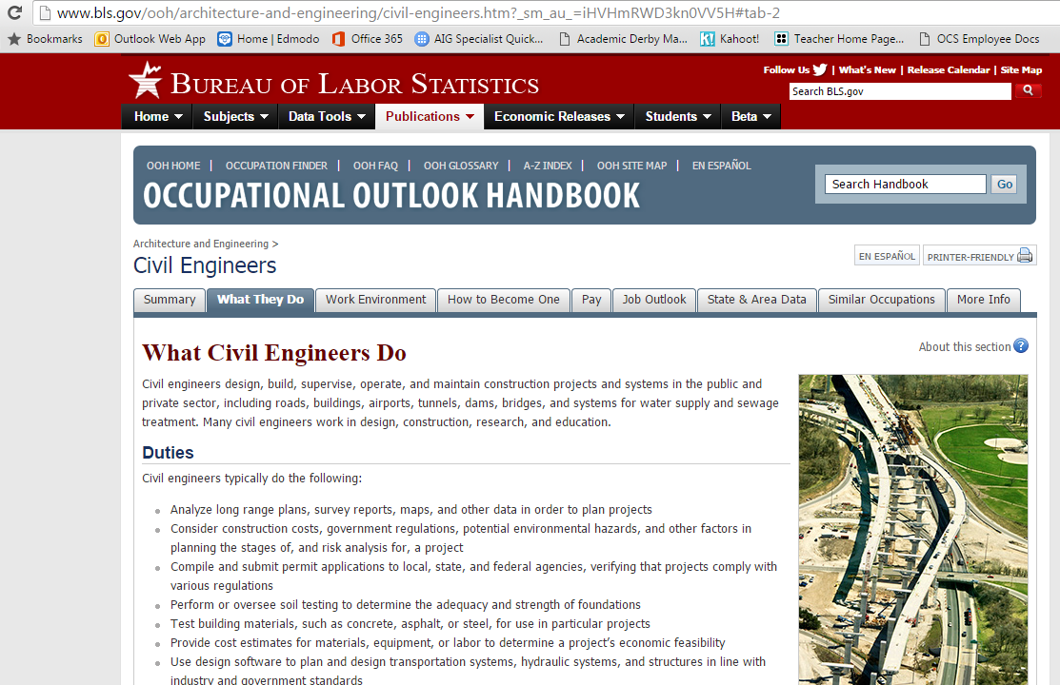

Slide 18
2014
Chart Paper

Slide 19
2016
OneNote
Class Notebook

Slide 20
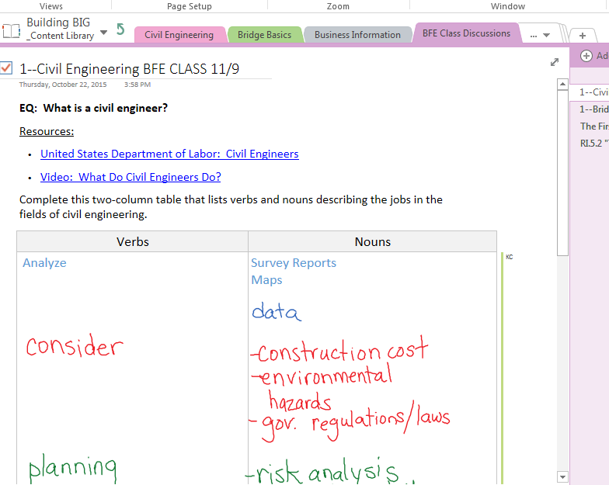
OneNote
Class Discussion Notes
Absent
New Students
Nonverbal
Twice Exceptional

Slide 21
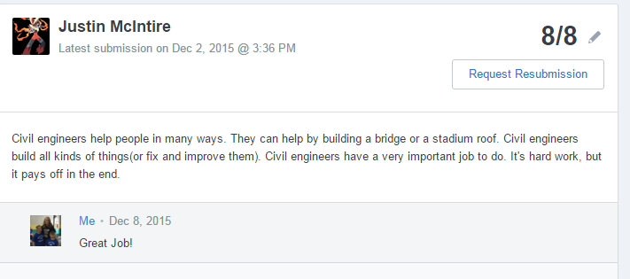
Exit Tickets through Edmodo
Edmodo Assignment:
Write a 5th grade quality paragraph describing what you have learned about civil engineering.

Slide 22
Phase 2: Bridge Basics
Essential Questions:
How do forces, materials, and shapes effect bridge design and efficiency?
What are the advantages and disadvantages of:
beam bridges?
arch bridges?
truss bridges?
suspension bridges?

Slide 23
Phase 2: Bridge Basics
PBS Building BIG Website
Forces, Load, & Materials Labs
Bridge Basics
Craggy Rock Challenge
Gumdrop or Paper Bridge Challenges
Bridge Bundle (TPT--$3.00)
Vocabulary Review in OneNote
Cargo Bridge (online game)

Slide 24
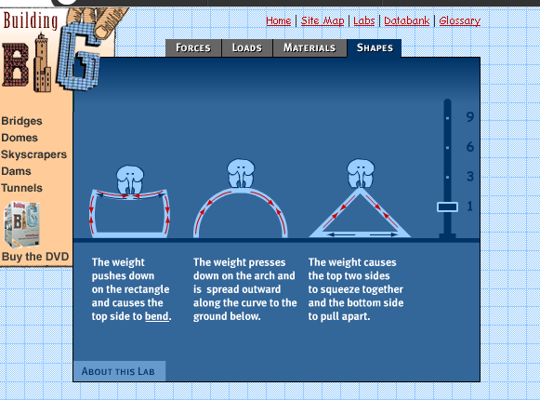
PBS Building BIG Lab Notes
Online Lab provides students opportunities to manipulate how forces, loads, materials and shapes effect bridges.

Slide 25
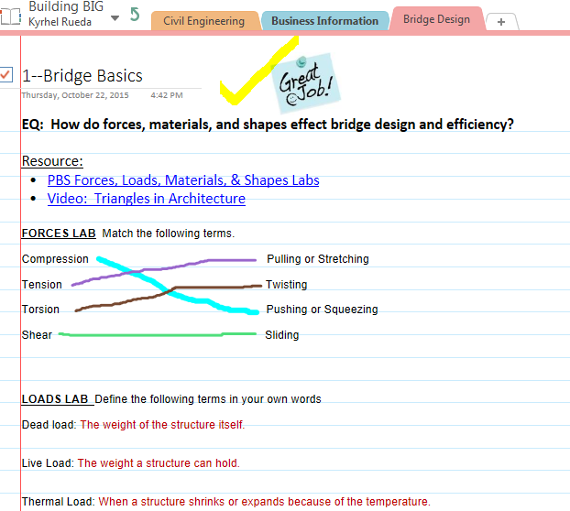
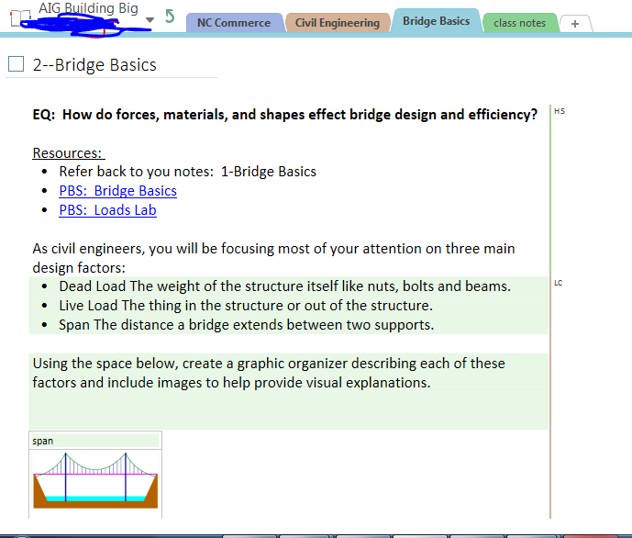
OneNote
for recording
lab notes

Slide 26
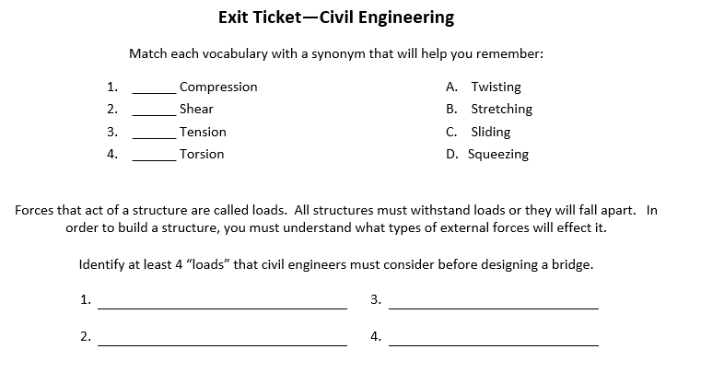
Paper & Pencil Assessment
2014

Slide 27
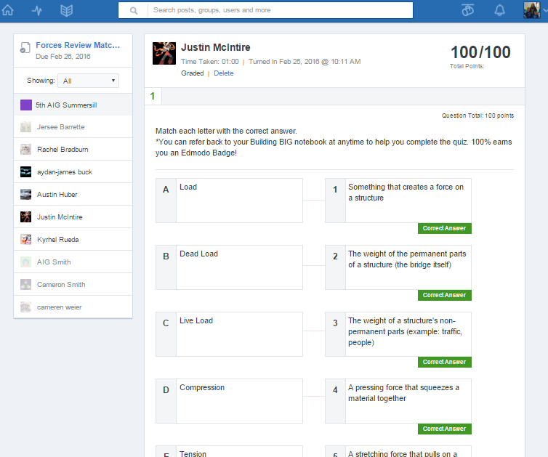
Exit Ticket using Edmodo Quiz

Slide 28
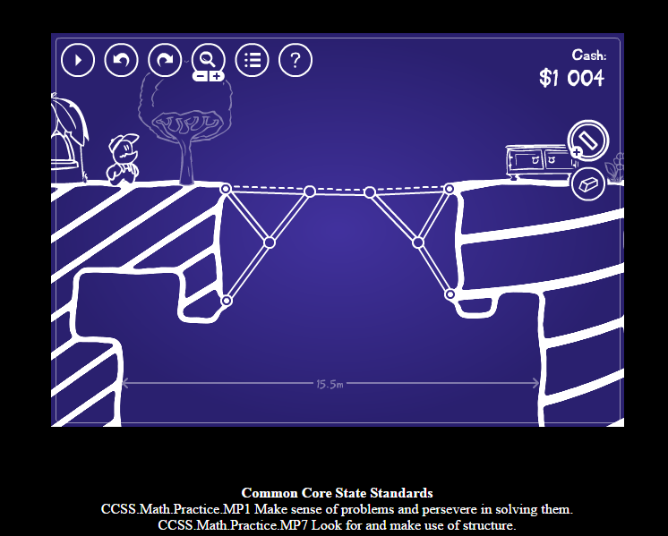
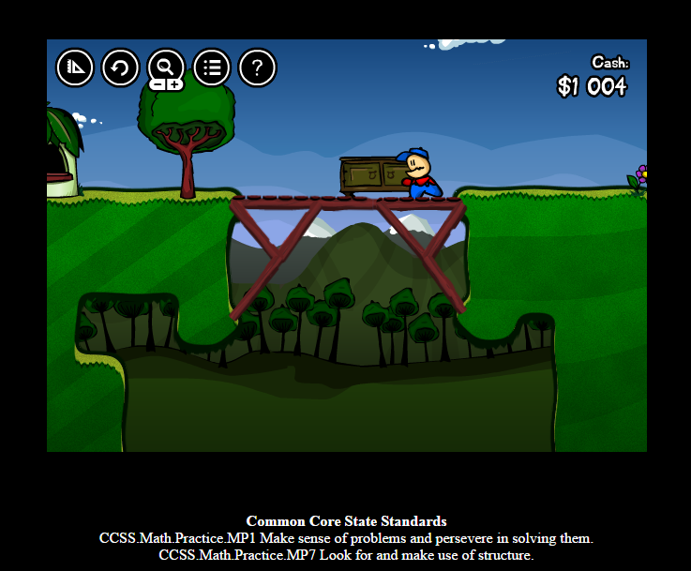
Cargo Bridge
Linked in Symbaloo & OneNote
Provides valuable practice for early finishers
Saves progress on same 1:1 device
Common Core State Standards
CCSS..MP1 Make sense of problems and persevere in solving them.
CCSS. MP7 Look for and make use of structure.

Slide 29
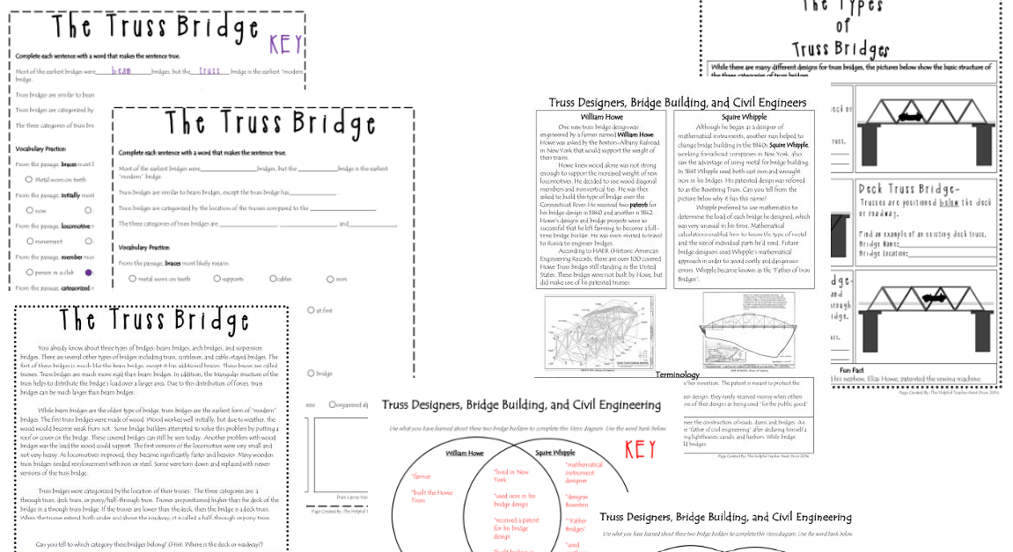
TPT: Bridges 1 and 2 Bundle made by The Helpful Teacher Next Door $3.00

Slide 30
Phase 3: Business Design
Essential Questions:
What factors do businesses consider when deciding on a name & slogan?
What make a successful logo?

Slide 31
Phase 3: Business Design
OneNote Collaboration Space
Business Name, Slogan, and Logo
Logo Flip Lesson
Postermywall.com
DesignMantic.com
Teamwork, compromise, and collaboration.

Slide 32
DesignMantic

Slide 33
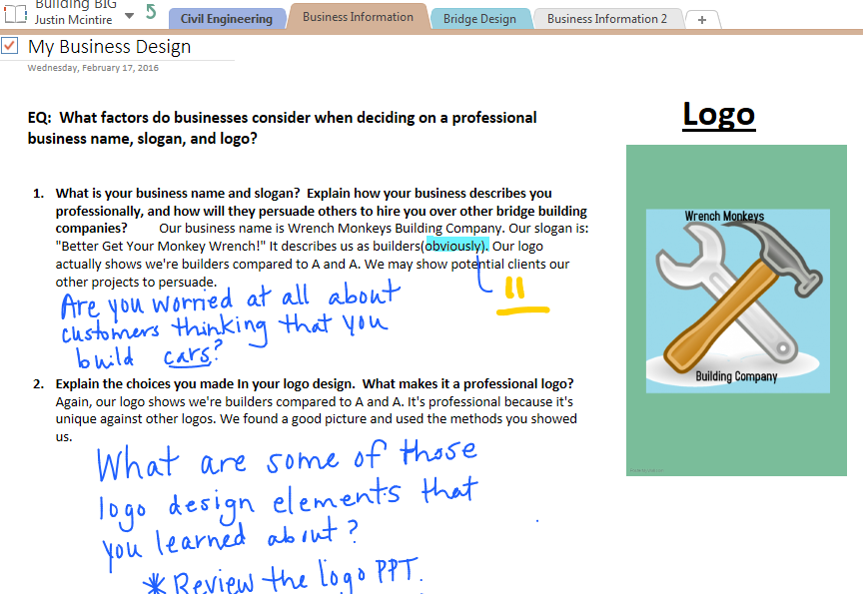
Provided feedback using my iPad
Logo design was created with postermywall.com

Slide 34
Assess Using GetKahoot.com
Before moving to Phase 4 of Construction, assess what your students have learned using GetKahoot.com.
This one is public and free to use, duplicate, and/or edit to fit your needs.

Slide 35
Assess Using Kahoot!

Slide 36
Phase 4: Construction
Essential Questions:
Why is it important to develop a basic budget for spending and saving?
How do I evaluate the costs and benefits of spending, borrowing and saving?
How does reflecting throughout the engineering process help you be more successful in your end-product?

Slide 38
Building Code & Budget
Design | Drawing of models are neat and legible Includes the actual distances of the spans and calculations of estimated materials needed Side truss view and bottom deck are drawn to scale & labeled Purchase orders are completed before each purchase. Construction reports are kept up to date.
Model | Bridge must span a 50cm river but not exceed 60 cm Bridge width (roadway) is between 7≥11 cm Bridge has 5 cm height clearance in the roadway to allow for the testing block to be held along with a 2 cm² opening to allow for the chain to hang Entire cost of building materials cannot exceed $300,000 dollars

Slide 39
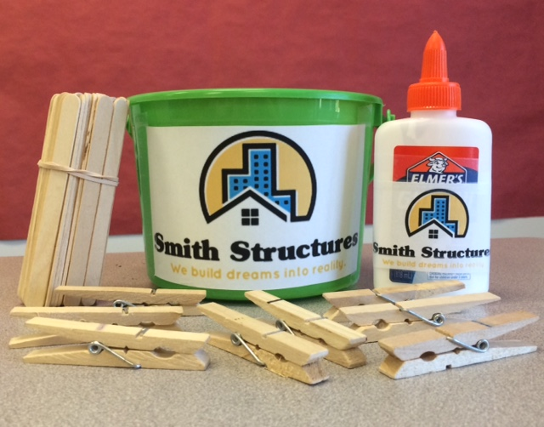
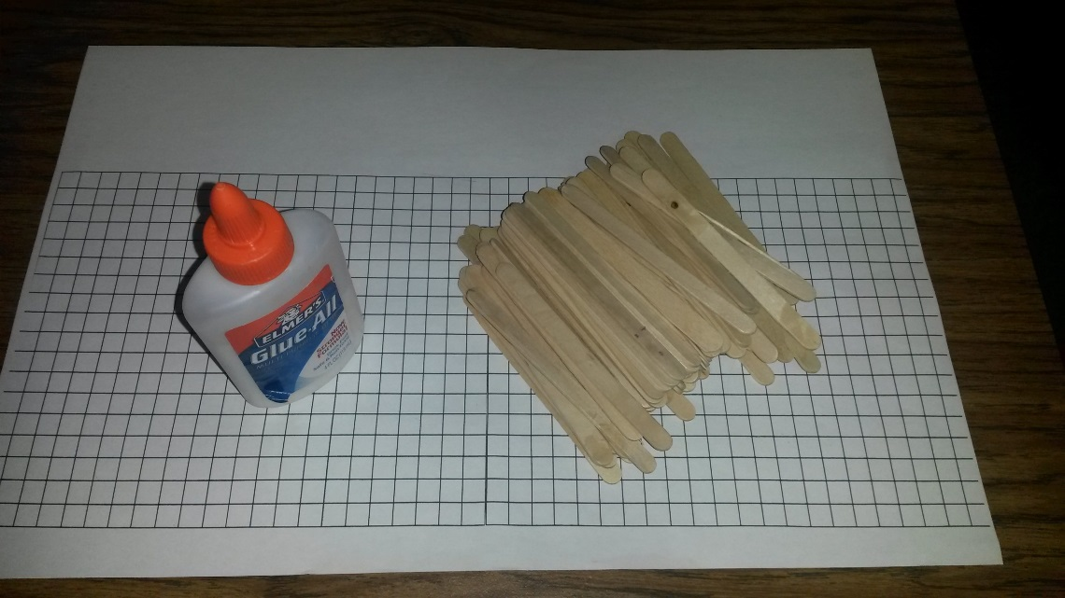
Construction Materials Needed
1 bottle of Elmer’s White Glue per team
At least 250 popsicle sticks per team
Centimeter grid paper
Storage container for each team
About 25 wooden clothes pins for each team (clamps)

Slide 40
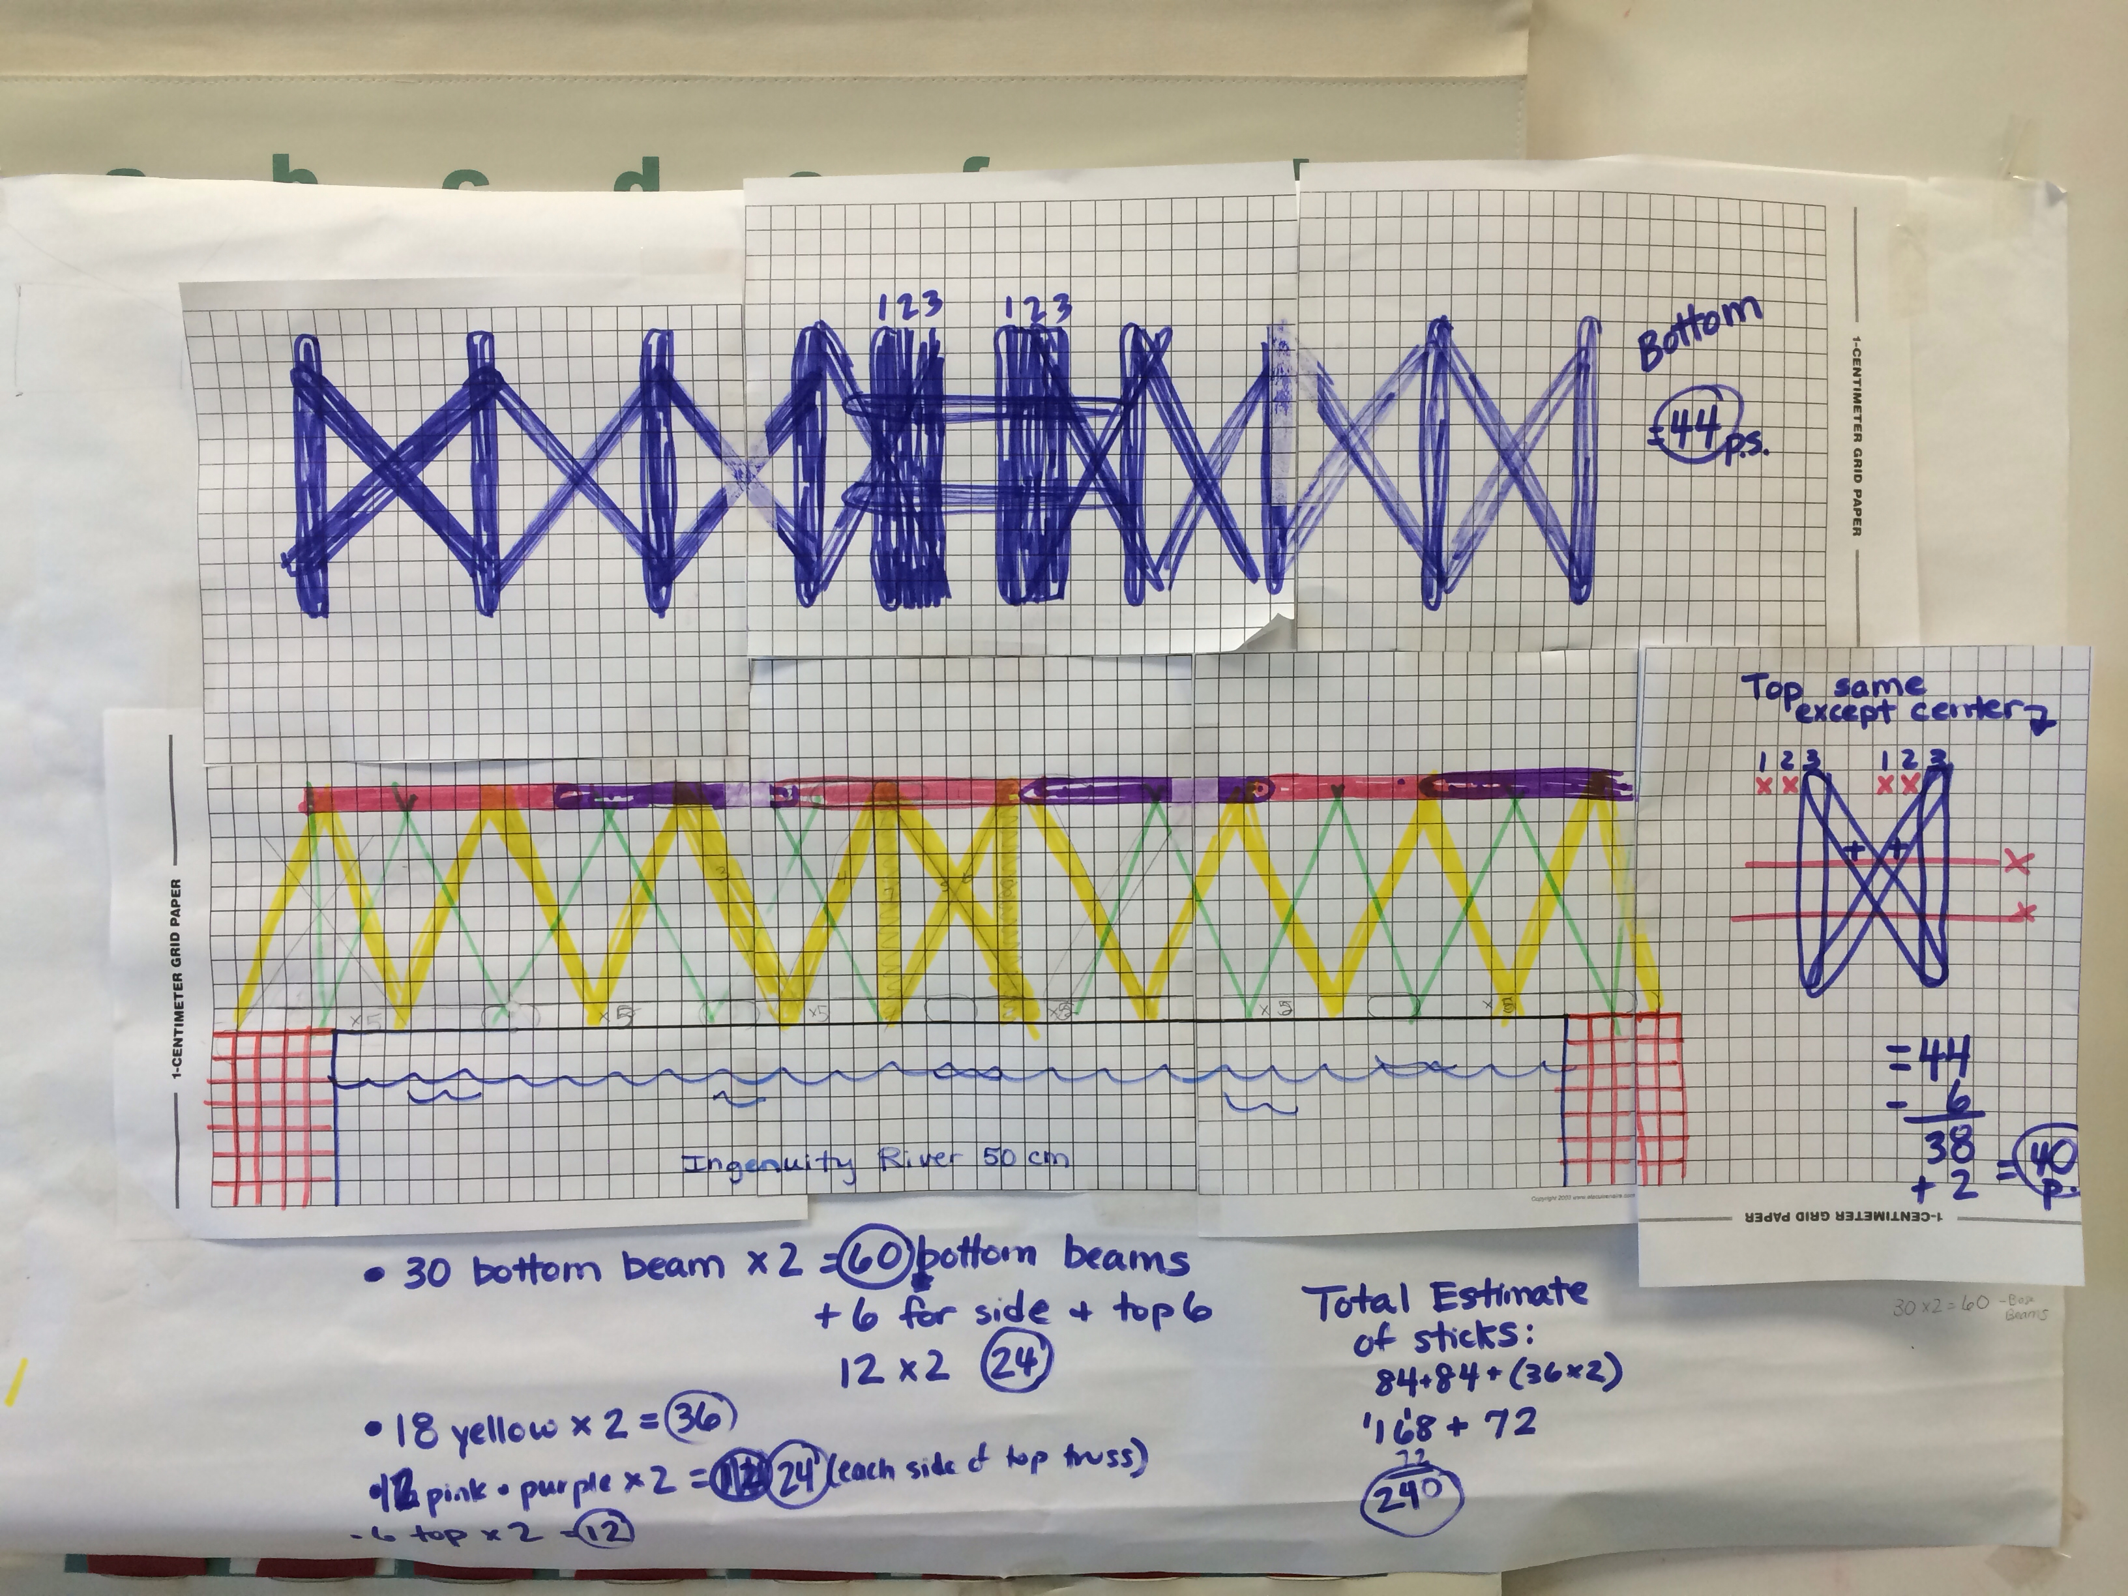
Blueprints & Estimates

Slide 41
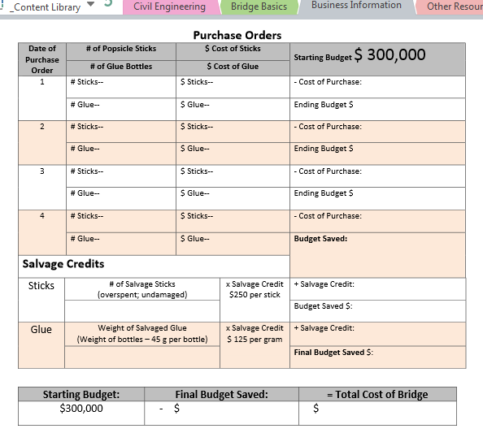
Purchase Orders & Salvage
Code & Budget Form
Password Protected!

Slide 42
OneNote Collaboration Space
Helps students set goals and plan ahead
Increases communication & collaboration
Encourages reflection throughout the building process

Slide 43
Phase 5: Final Analysis
Essential Questions:
Why is it important to develop a basic budget for spending and saving?
How do I evaluate the costs and benefits of spending, borrowing and saving?
How does reflecting throughout the engineering process help you be more successful in your end-product?

Slide 44
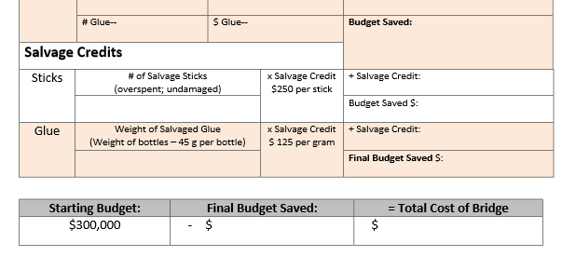
Salvage Credits
Bottom portion of Code & Budget form

Slide 46
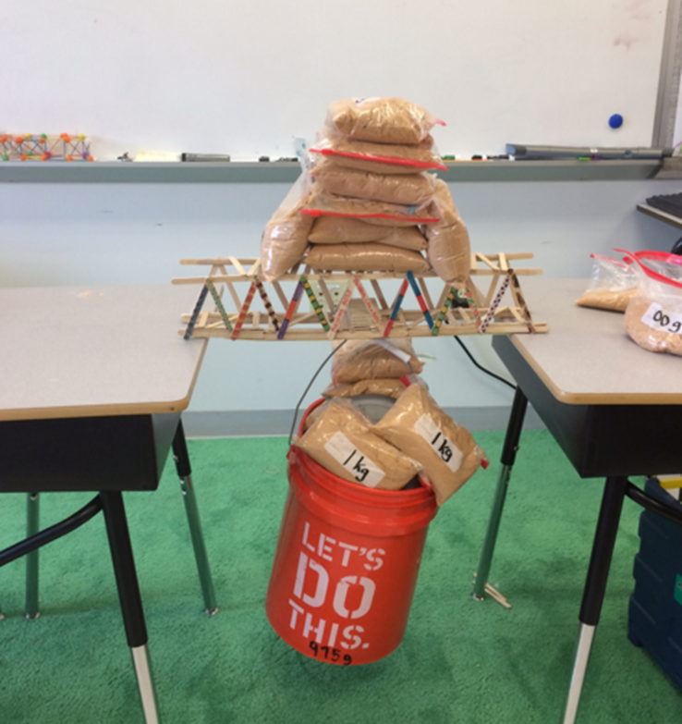
Testing Materials Needed:
Testing Block
Strong bucket (Home Depot)
50lb bag of Playground Sand
Strong Ziploc bags

Slide 47
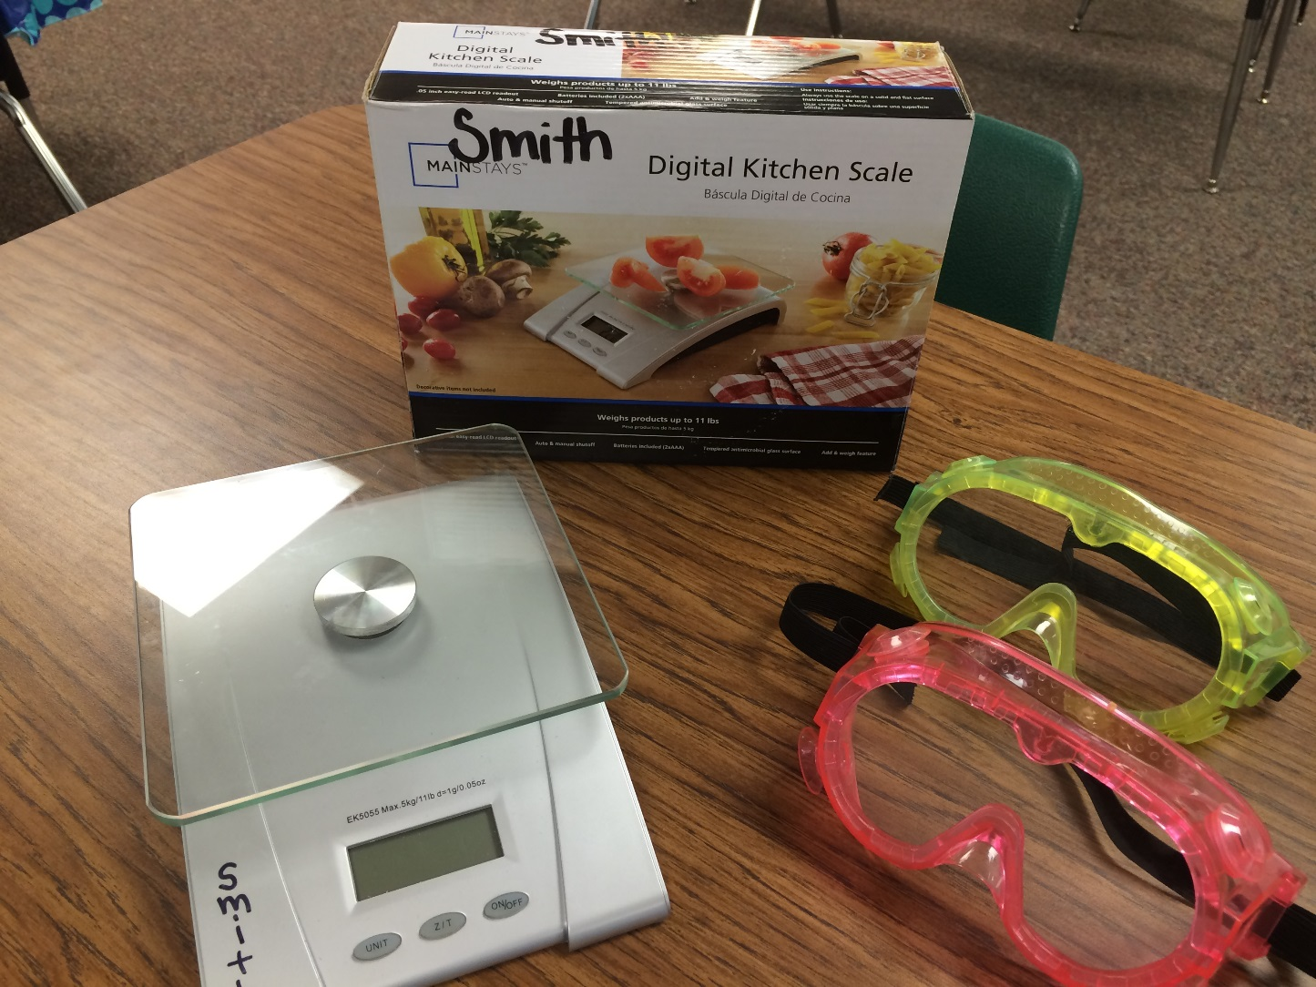
Testing Material Needed:
Digital Scale (g)
Dead Load
Sand Bags
Glue Salvage
Safety Goggles

Slide 48
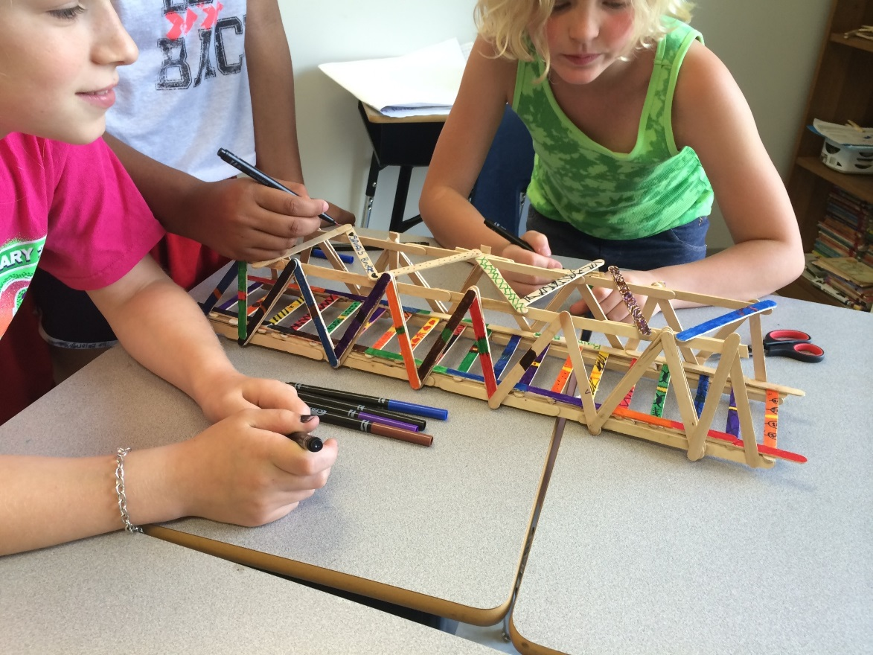
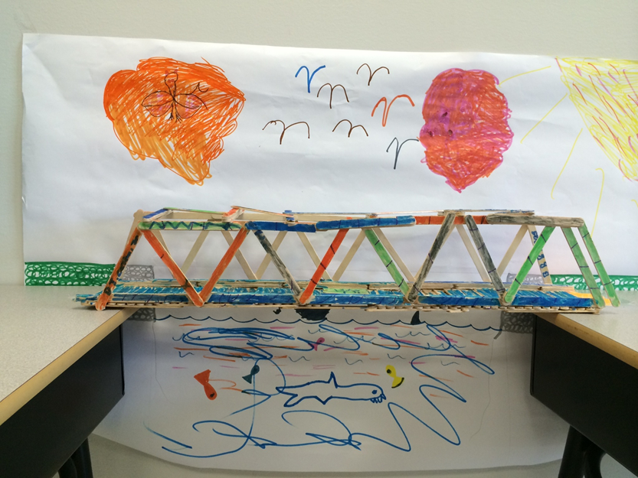

Slide 49
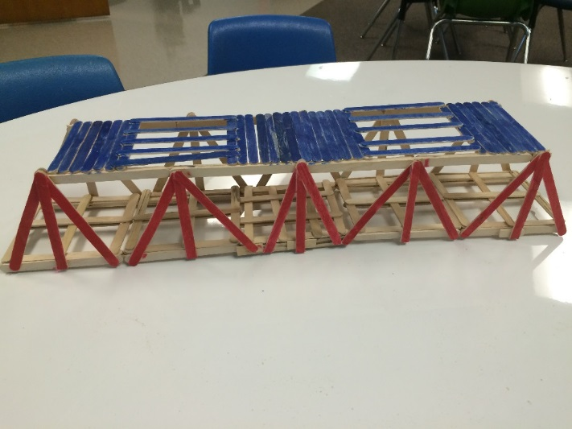
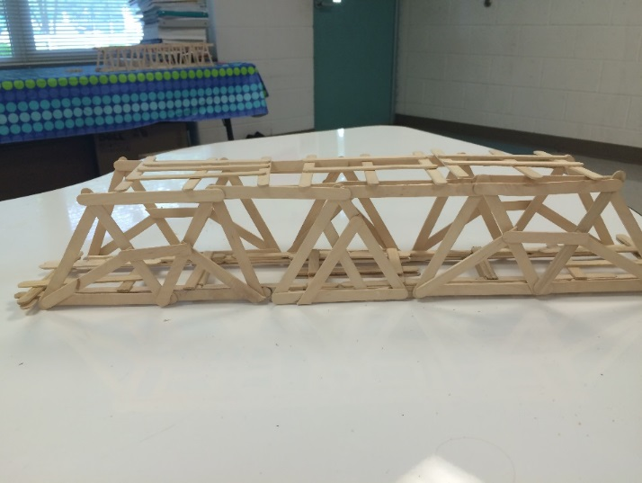
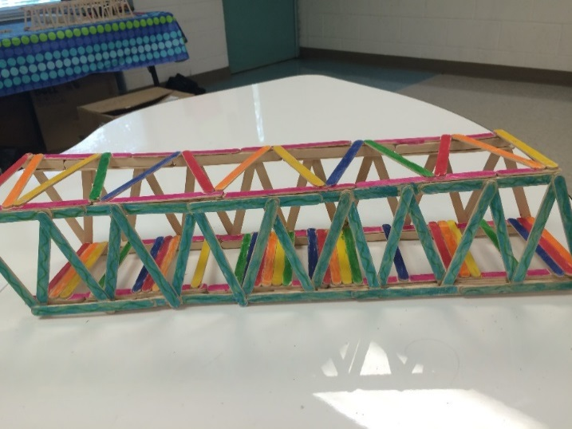
2015 Bridges

Slide 50
Budget Score + Efficiency Score = Overall Score
Bottom portion of Final Bridge Analysis

Slide 51
2015—Movie Maker

Slide 52
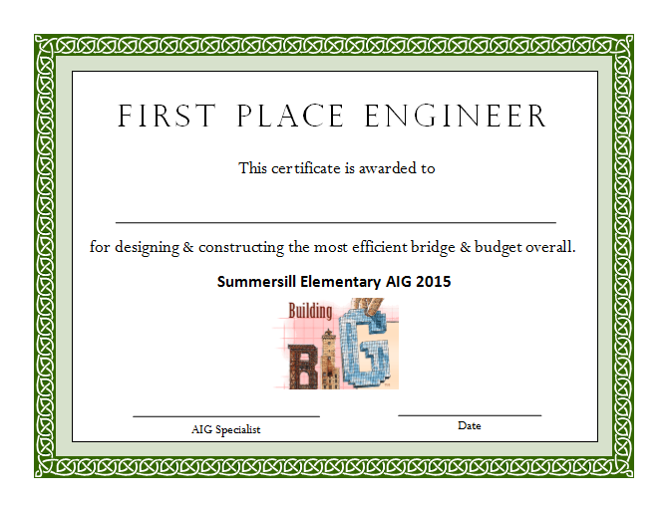

Slide 53
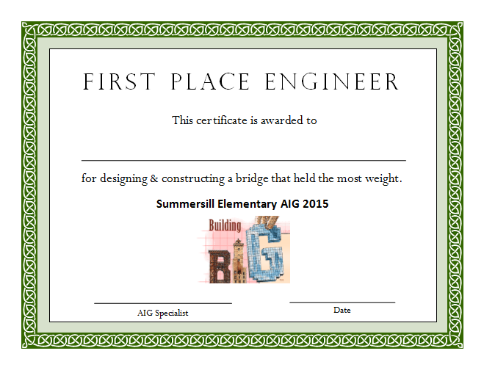

Slide 54
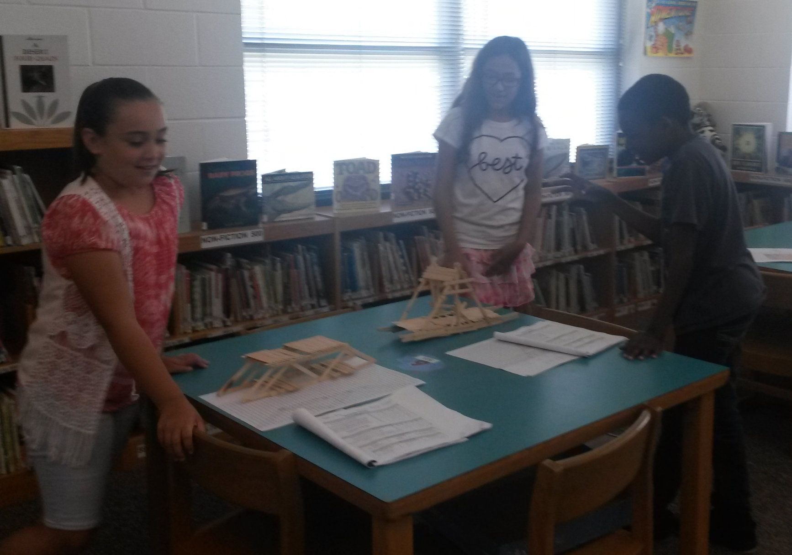
Engineering Fair

Slide 55
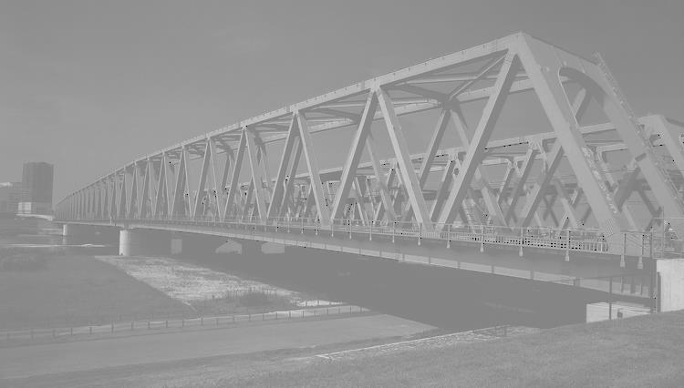
Engineering Bridge Fair
Company: KHA Company
Engineers: Kiley Hodnefield, Harley Yates & Avy
Efficiency Rating: 69.37
Bridge Cost: $164,800
Engineering Inspector: Mrs. Maria Burdette

Slide 56
Join our Edmodo Group for all the resources from today!
Group Code: 9ps7cz

