Slide 1
Differentiation: Math Focus
Michael Elder
Academic Innovation and Gifted Services
Onslow County Schools
March 2017
http://www.simpletruths.com/motivational-quote-videos.html

Slide 2
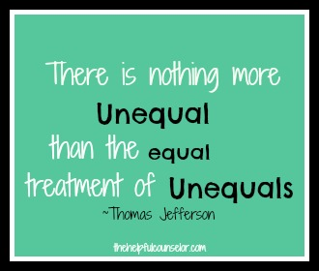

Slide 3
The Five Dimensions of Differentiation
Content
(Knowledge)
Process
(Pedagogy)
Yourself
Learning Environment
Products
(Expression Styles)

Slide 4
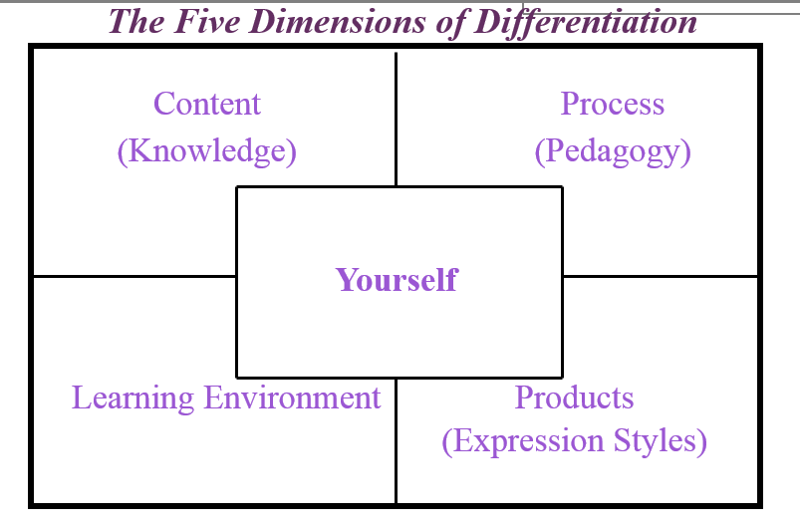
Math Skills
Basic Facts
Content Differentiation
Process Differentiation
Product Differentiation
Environment Differentiation
Teacher Differentiation
Discussion: 1 minute

Slide 5
Math Concepts
Elementary: Place Value Middle/High: Slope
Content Differentiation
Process Differentiation
Product Differentiation
Environment Differentiation
Teacher Differentiation
Discussion: 1 minute

Slide 6
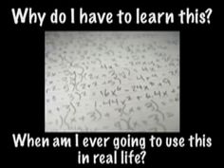
Science and Math: What is relevant? To Kids?
What do gifted students (and others) always ask?
What are some ways to make math relevant to students?
One Idea Adjusting the process or the learning environment NewsELA
https://newsela.com/articles/#/subject/science-and-math
So many examples, so little time
www.yummymath.com
http://www.discoveryeducation.com/
Notes:
Am I going to need to know this for the test?
And more importantly why or why does it matter?

Slide 7
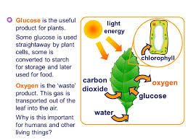
Brain Research
New Synapses are created with early sensory development
Eric Jensen, “Teaching With the Brain in Mind”
Children’s minds burn 225% the adult level of glucose
Keys: Stimulation, repetition, novelty
Without the keys, synapses are shed

Slide 8
Do I have to Differentiate?
This is generally considered to be conservative
In Reading

Slide 9
Classroom Leadership “Management”

Slide 10
Classroom Management Grouping Strategies
Level of Achievement (1 being the highest)
Student 1 | Student 2 | Student 3 | Student 4 | Student 5
Student 6 | Student 7 | Student 8 | Student 9 | Student 10
Student 11 | Student 12 | Student 13 | Student 14 | Student 15
Student 16 | Student 17 | Student 18 | Student 19 | Student 20
Student 21 | Student 22 | Student 23 | Student 24 | Student 25
Student 26 | Student 27 | Student 28 | Student 29 | Student 30
Level of Achievement (1 being the highest)
John | Sally | James | DaQuan | Fred
Michelle | Pam | Suzanne | Brent | Dwayne
Michael | Corinne | Lesley | Cheryl | Terri
Angela | Luis | Tom | Cathy | Diane
Sean | Sydney | Louise | Dave | Sue
Jamal | Antonio | Brian | Heidi | Ernie
How could this organization help in creating groups?

Slide 11
Classroom Management
Managing Noise in a Differentiated Classroom
https://bouncyballs.org/

Slide 12
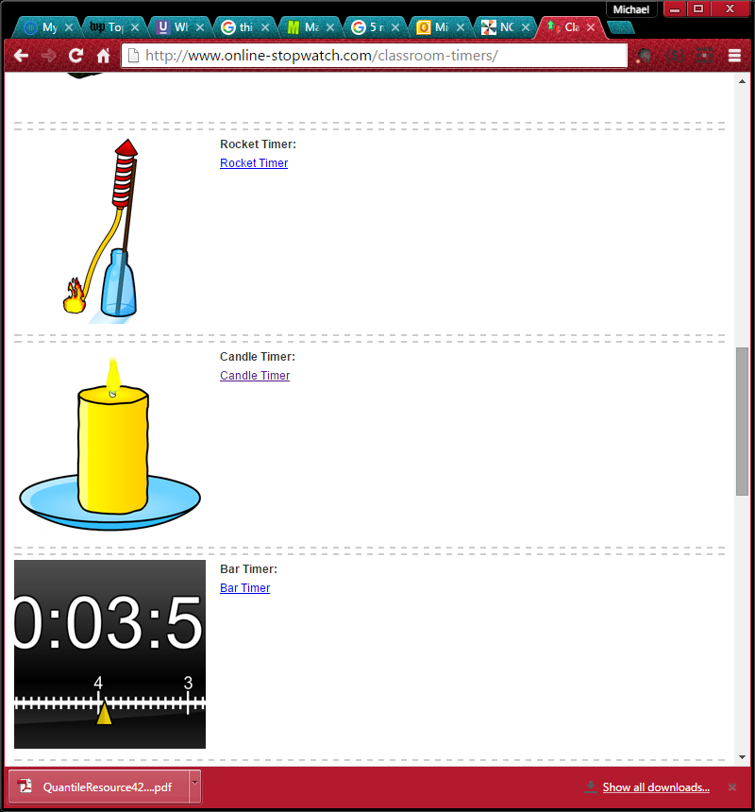
Classroom Management
Managing Time in a Differentiated Classroom
http://www.online-stopwatch.com/classroom-timers/

Slide 13
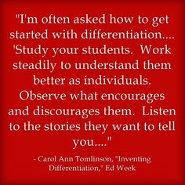

Slide 14
Two Keys For Differentiation Success

Slide 15
Anchor Activities
“But, I’m done!”
“What do I do when I am done?”
Meaningful
Manageable
Motivational

Slide 16
Anchor Activities
Specific, ongoing, independent activities on which students work independently
ongoing assignments that students can work on throughout a unit
relate to the concepts and the content being learned
engaging, meaningful tasks
activities that everyone in the class will have a chance to do

Slide 17
Anchor Activities
Amazing List of Possibilities
Key is to avoid busywork, but rather have options for important work
Can be group, but generally individual
Can be at varied levels
Do not need to be assessed
Management System is needed
Possibly Ask, “What would a professional in the field do if they had time to explore this topic?”

Slide 18
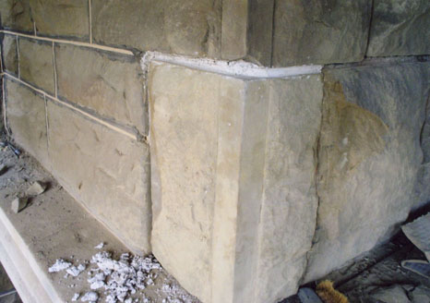
The Cornerstone of Differentiation in Math

Slide 19
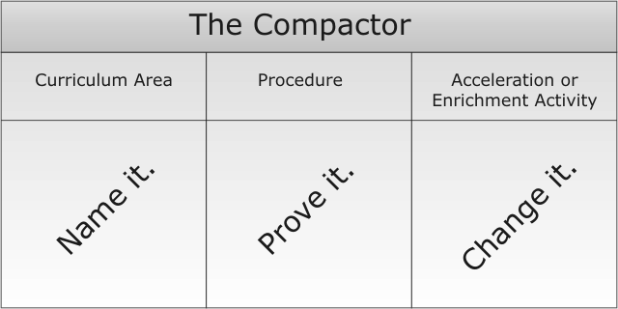
Key #2 Curriculum Compacting
Assesses what a student knows and what content is not yet mastered
Content not yet mastered becomes part of learning goals
Previously mastered content is not required thereby “freeing up” time for enriched, accelerated, or interest driven activities
Renzulli & Reis (1997)
Tomlinson (1995)

Slide 20
When teachers eliminated as much as 50% of the curriculum, no differences were found between treatment and control groups in most content areas. In fact, students whose curriculum was compacted scored higher than control group students in some areas.
Reis, S. M., Westberg, K.L., Kulikowich, J., Caillard, F., Hébert, T., Plucker, J., Purcell, J.H., Rogers, J.B., & Smist, J.M. (1993). Why not let high ability students start school in January? The curriculum compacting study (Research Monograph 93106). Storrs, CT: The National Research Center on the Gifted and Talented, University of Connecticut.

Slide 21
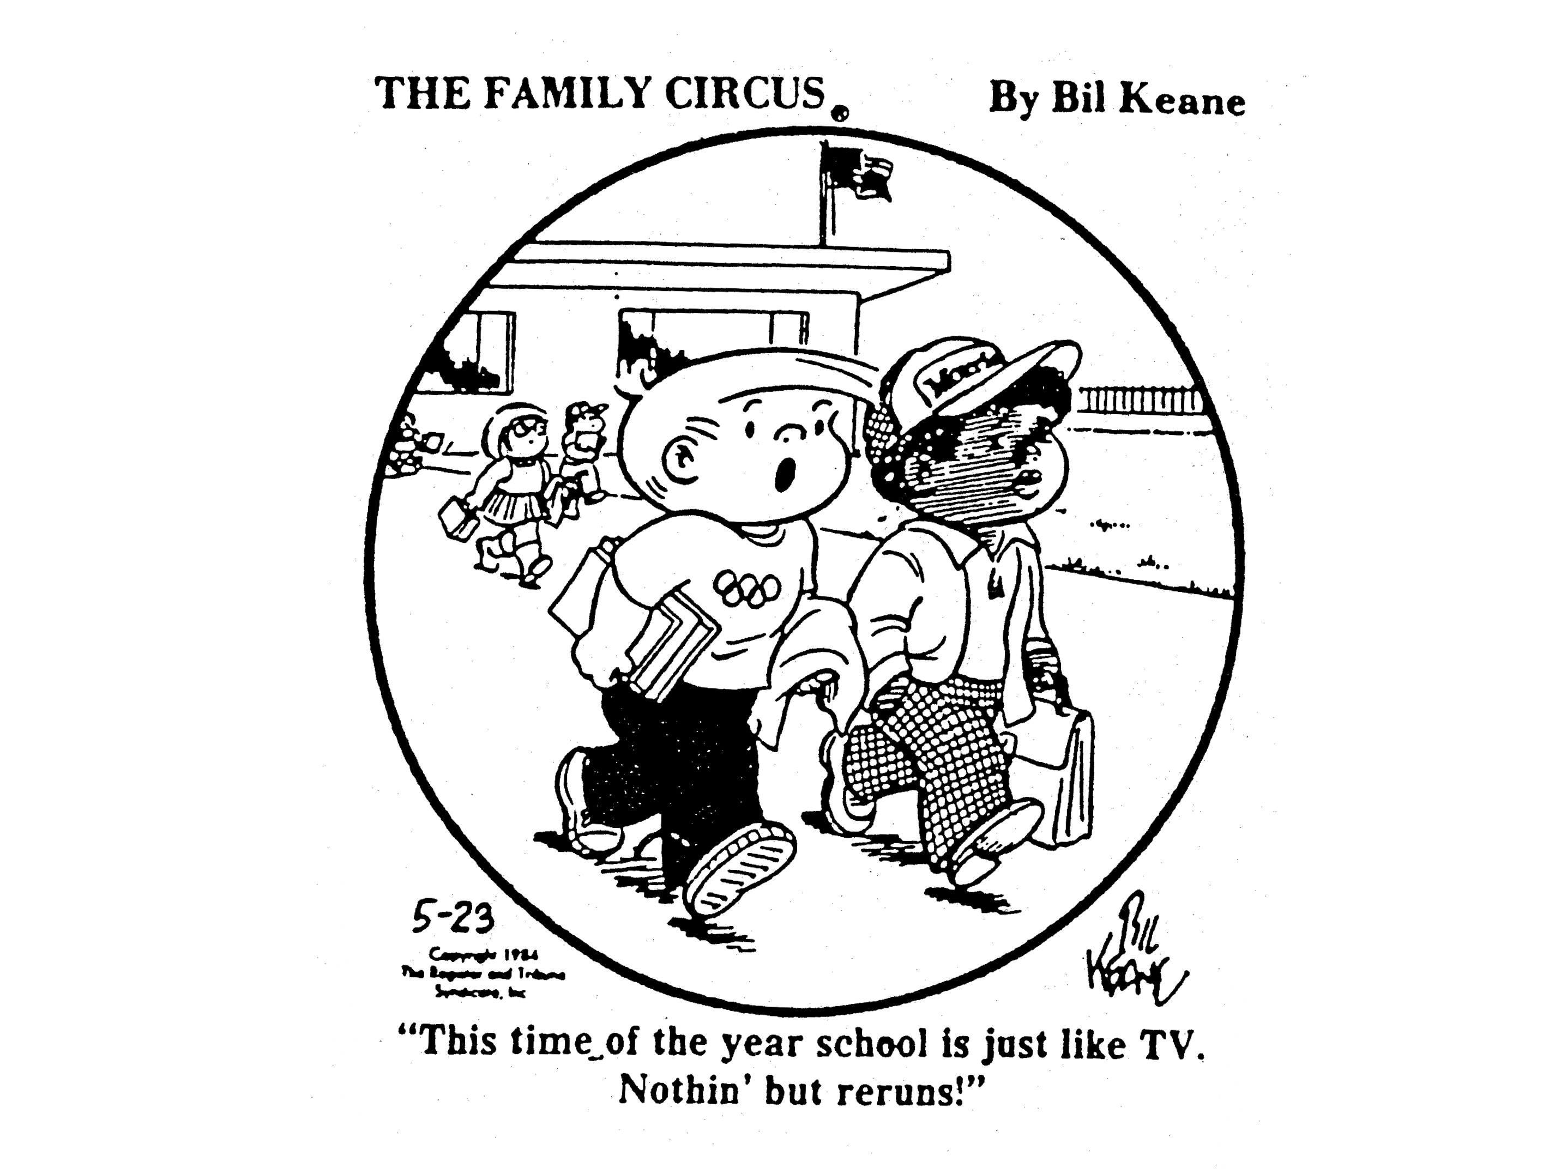

Slide 22
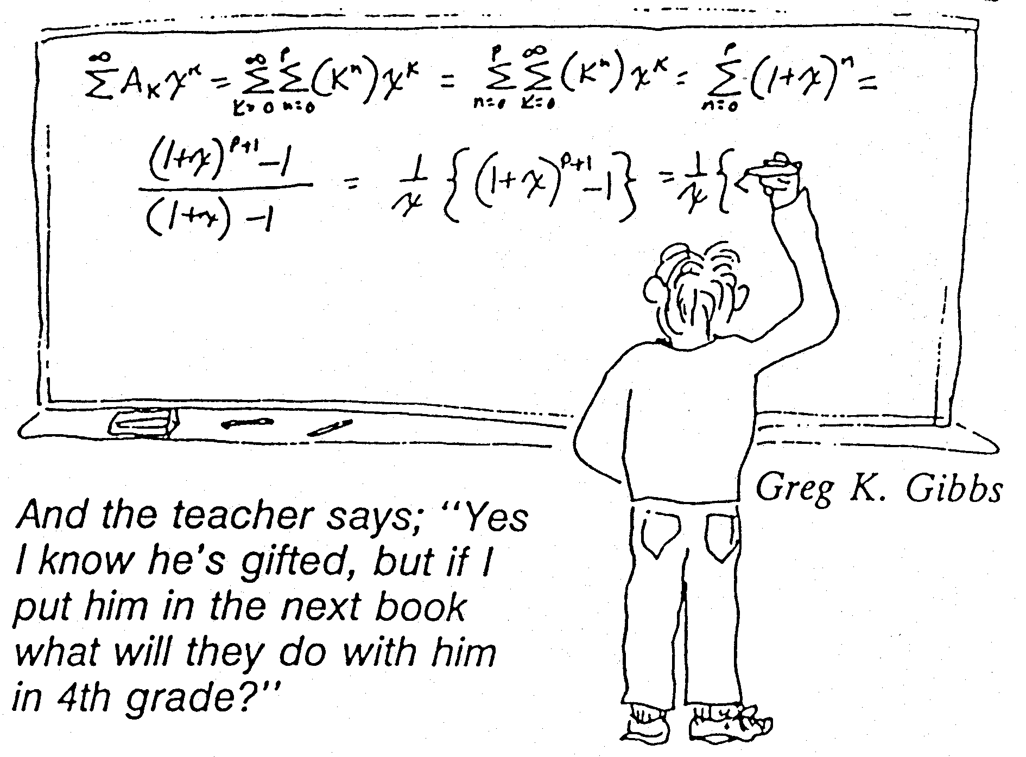

Slide 23
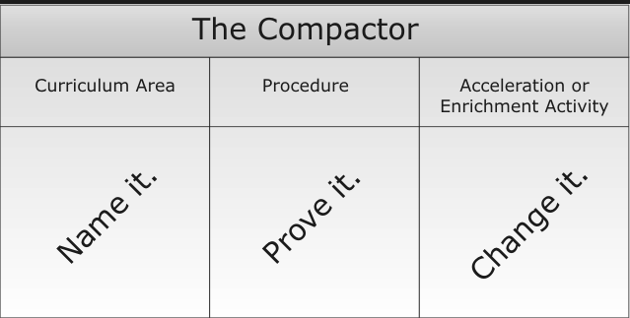
Let’s Try: Topic Elementary Fractions
If I know students can already __________________ then I am good with them moving on to do _____________________________.
What are some common areas of fractions that we want 4th or 5th graders to master?
How can they show us they have mastery?
What will they do instead once they have shown mastery?

Slide 24
Two Resources

Slide 25
Grades 3-5
Quantile & Lexile Score Given for Each Child
http://www.ncpublicschools.org/docs/accountability/uisrs/eoguisr12.pdf

Slide 26
Tools: Quantiles

Slide 27
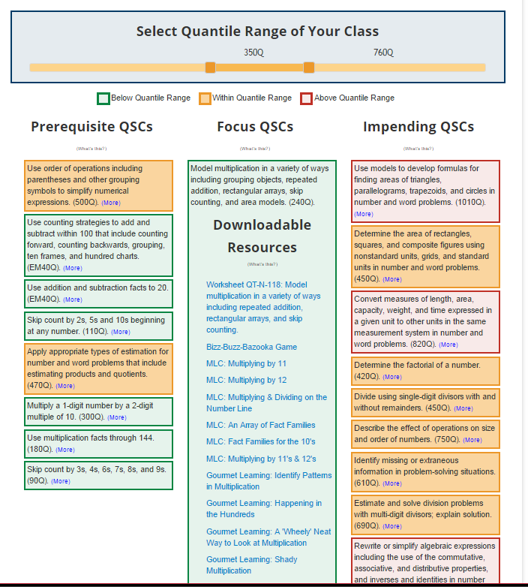
Tools: Quantiles

Slide 28
Tools: NC DPI Instructional Resources Project

Slide 29
Tools: NC DPI Instructional Resources Project

Slide 30
Tools: NC DPI Instructional Resources Project

Slide 31
Strategies
Differentiation is a Mindset not a set of strategies
Even so, we all need strategies
Authentic/Project Based Learning
Tiered Assignments
Leveled Questions
Multiple Intelligences
Choice Board
Learning Contracts?

Slide 32
More For You

Slide 33
Other Resources and Thoughts
The Why
The “Pre-work”
4 Tools
5 Strategies

Slide 35
Brain Research
William Greenough- enrichment
Two Critical Requirements to Build a Better Brain
Appropriate Level of Challenge
Specific, clear, timely, multimodal, interactive feedback
The brain is specifically designed to operate on feedback

Slide 36
Brain Research
Classroom Environments
Grow dendrites and save synapses through enriched learning experiences
Shed synapses due to lack of stimulation
Brain does not process meaningless information
Students must make sense of what they are learning
Phil Schlechty: Students learn by what they do
The Brain is innately collaborative and social

Slide 37
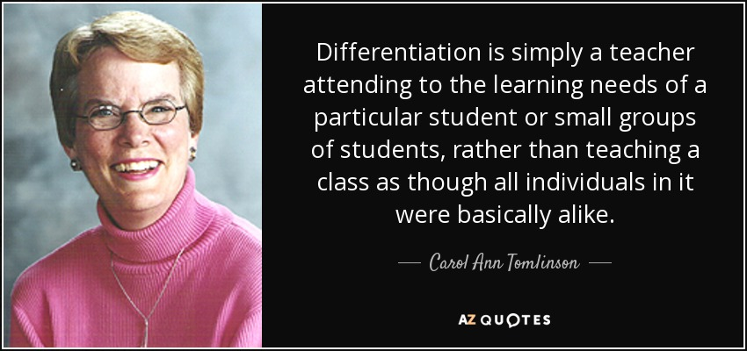

Slide 38
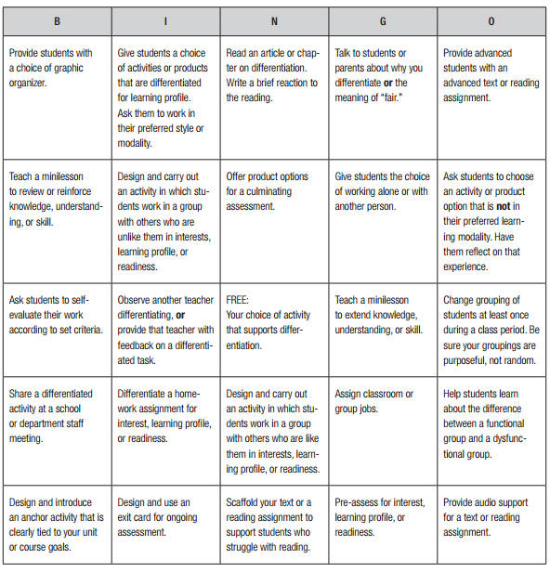
Differentiate in Math? Seriously?
What are the great struggles as you think about differentiation?

Slide 39
Myths of Differentiation
There is only one right way to differentiate
You have to differentiate all the time to be effective
Differentiation cannot include whole-group instruction.
Differentiation does not really work when you have high-stakes testing.
Differentiation is best for students who are in special education

Slide 40
Myths of Differentiation
Differentiation means the same thing as individualization or personalization.
Differentiating curriculum does not encourage mastery for all students.
Differentiation leads to unbalanced workloads.
You have to group students and stick with those same groups to be successful.
Above-grade-level students should be used as tutors for struggling students.

Slide 41
Myths of Differentiation
Differentiation is not fair to the students.
Assessment is not challenging enough when you differentiate

Slide 42
Tools
Differentiation is a Mindset not a set of tools
Even so, we all need tools
SUDDS (6-8)
TurnonCCMath (k-8)
Quantiles
NC DPI IRP

Slide 43
Tools: SUDDS

Slide 44
Tools: SUDDS

Slide 45
Tools: SUDDS

Slide 46
Tools: Turn on CC Math
By Grade Level or
By Strand Trajectory

Slide 47
Tools: Turn on CC Math
By Grade Level or
By Strand Trajectory

Slide 48
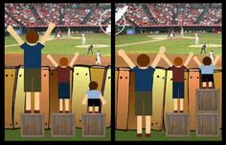
Equal
Differentiated

Slide 50
Project/Problem Based Learning

Slide 51
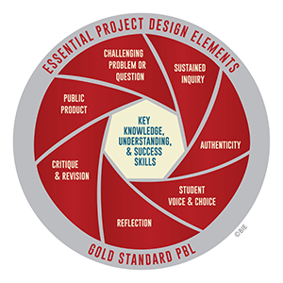
Project/Problem Based Learning
Buck Institute (www.bie.org)

Slide 52
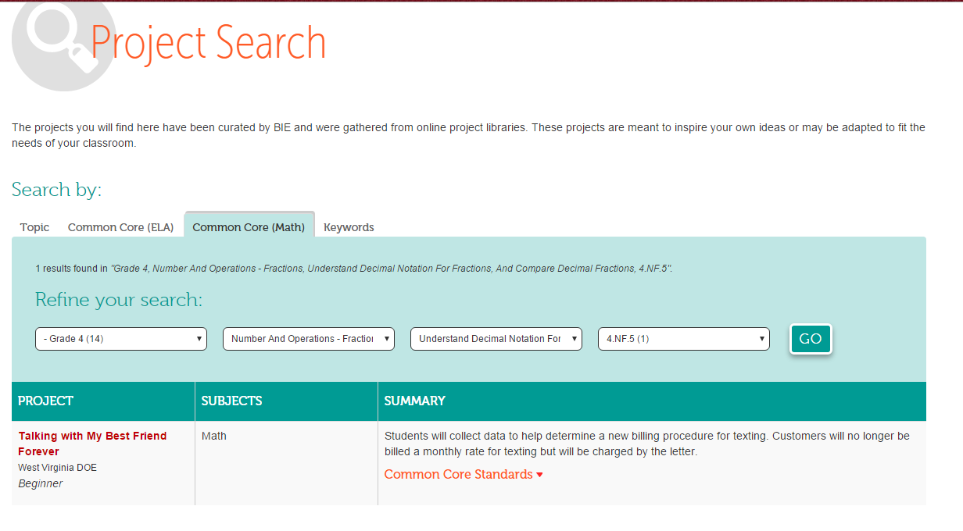
Project/Problem Based Learning
Buck Institute (www.bie.org) Project Search

Slide 53
Tiered Assignments
Math Topic: Measurement
K-2: Great Feat
3-5: Kids Just Want to Play
6-8: Rectangular Prisms, Cylinders, and Cones
9-12: Applying Dilations

Slide 54
Tiering, An Overview
Scaffolding
Same instructional/learning goal
Honors different levels of ability and interest
Consider teaching how to cook Thanksgiving Dinner
What would be the goal?
What different levels of readiness could we expect?
How could we know what levels to prepare for?
What types of learning experiences would each person need/deserve?
Can you see the tiers emerge?

Slide 55
Tiering: General Steps
Pick the grade level objective/standard you will be addressing
Decide on the specific skills, concepts, or generalizations that need to be learned.
Plan an activity that teaches the skills, concepts or generalizations. This base activity should be on-grade-level.
Examine the task for complexity How could it be made less complex? How could it be made more complex?
Create tiered assignments English Language Learners- add context; make more personal; make more visual Below Grade Level- Smaller pieces; greater support; increased visuals; Above Grade Level- increase complexity or decrease structure (open-ended, creativity-centered, research)
Pre-assess using discussions, quizzes, tests, journals to establish groups
Distribute assignment sheets (or online assignments) to appropriate students and proceed with lessons.

Slide 56
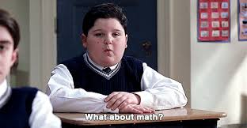

Slide 58
Diving In (or Stepping In)
Topic of Study: Measurement
A Great Feat (k-2)
Kids Just Want to Play (3rd -5th)
Rectangular Prisms, Cylinders, and Cones (6th-8th)
Applying Dilations (High School)

Slide 59
A Great Feet (k-2)
What is the goal or the standard being addressed?
Non-standard and standard units of measure
What do all students do?
Listen to the story
Trace and cut out their shoe print
Measure each other’s height with the shoe print
Make a visual of height (in shoe units)
How is it tiered?
Expectations on what to do with the cut-out
Moving to standard units
Possible Anchor Activity: Inchworm Measurement

Slide 60
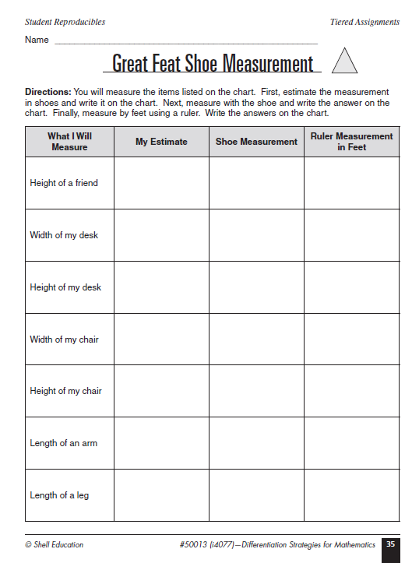
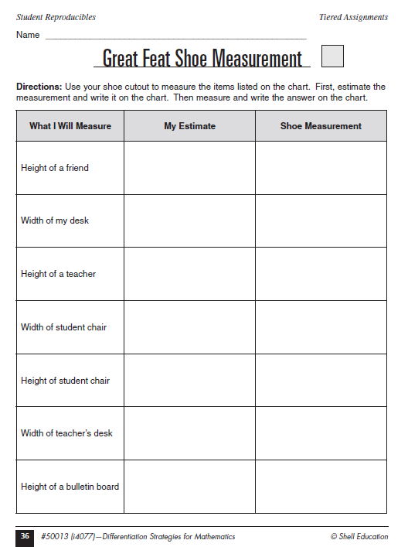
File Name: Page035.pdf

Slide 61
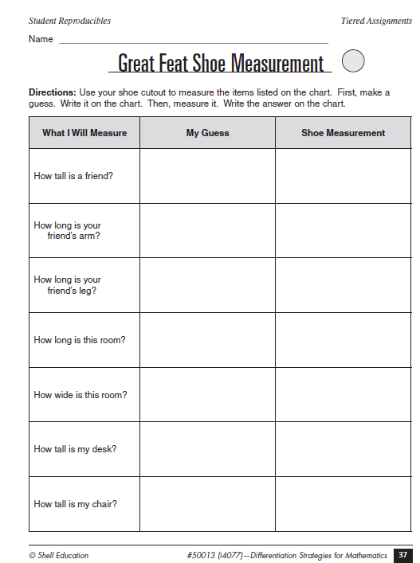
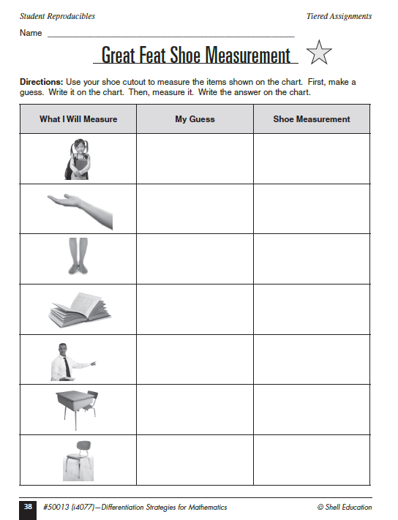
File Name: Page035.pdf

Slide 62
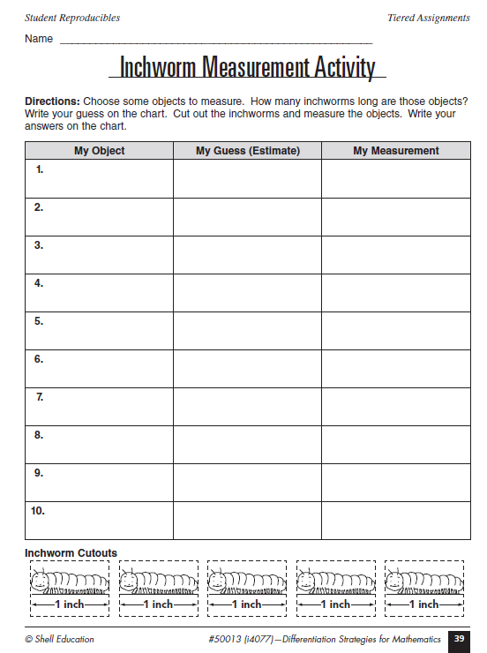
Possible Anchor Activity: Inchworm Measurement
File Page039.pdf

Slide 63
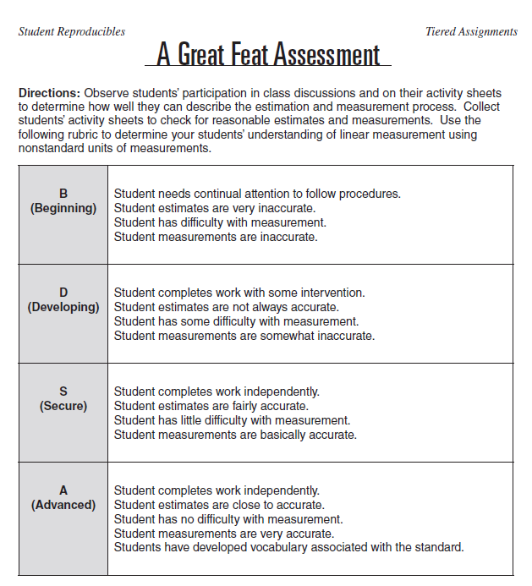
A Great Feat Assessment
File: Page040.pdf

Slide 64
Kids Just Want To Play (Grades 3-5)
What is the goal or the standard being addressed?
Perimeter
What do all students do?
Explore perimeter
Design a playground with 1000 feet of fence
Draw a model
Possible Anchor Activity
Students explore other shapes for playgrounds. Which shape will give the most room to play?

Slide 65
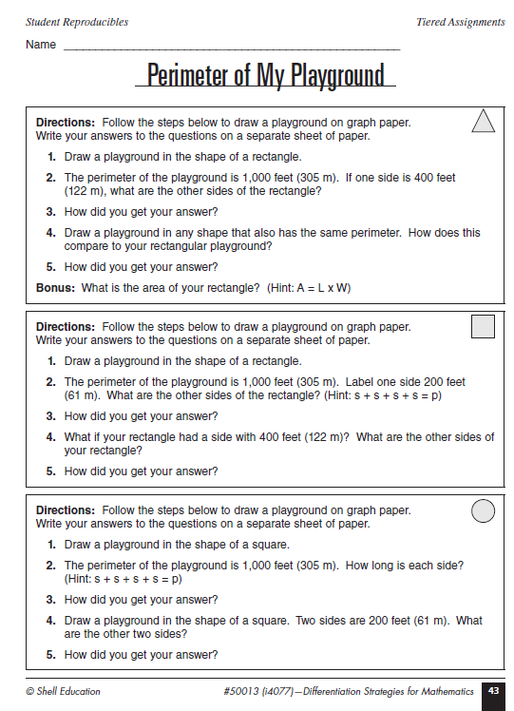
File: Page043.pdf
Cut Into strips
Each Group has a slightly different task
What do you notice about each task?
When students are done in homogeneous groups, jigsaw to share.

Slide 66
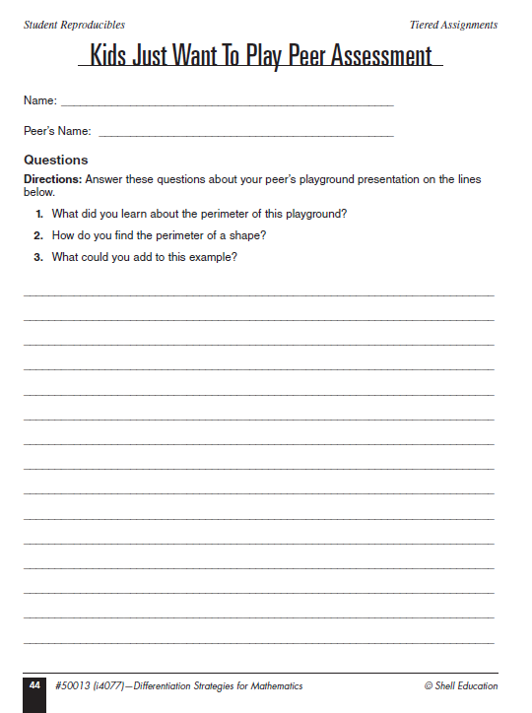
Kids Just Want to Play Peer Assessment File: Page044.pdf

Slide 67
Rectangular Prisms, Cylinders, and Cones Grades 6-8
What is the goal or the standard being addressed?
Volume and Surface Area (Rectangular Prisms, Cylinders, and Cones)
What do all students do?
Receive 27 CM Cubes and asked to create a 3x3x3 cube
Discuss area, volume, and surface area
Draw a net of the cube
Brainstorm types of solid figures
Possible Anchor Activity
Working with Triangular Prisms

Slide 68
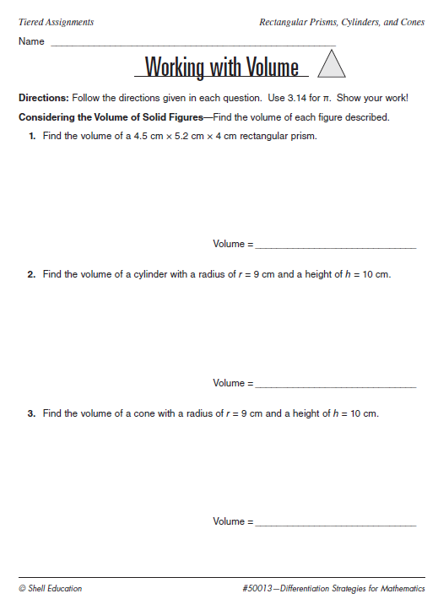
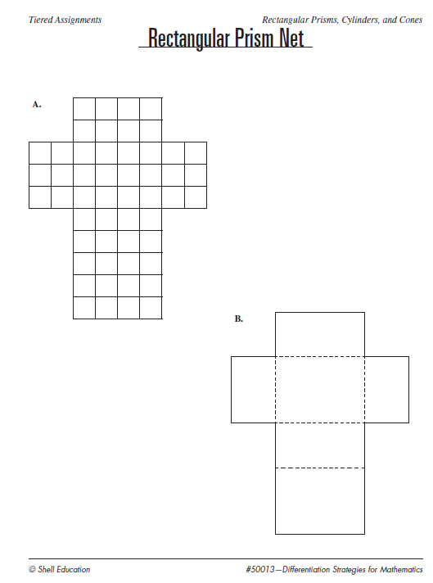
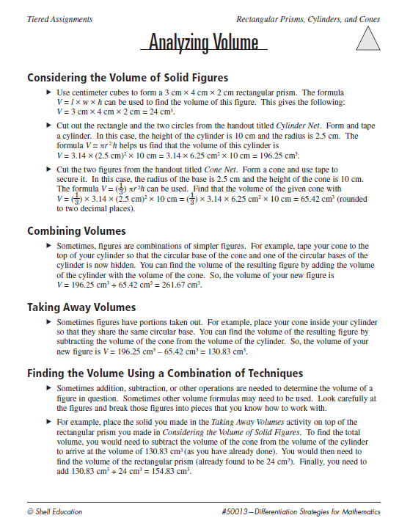
Above Grade Level
Calculator
30 or more cm cubes
Scissors and Tape
Analyzing.pdf
Working.pdf
Nets.pdf

Slide 69
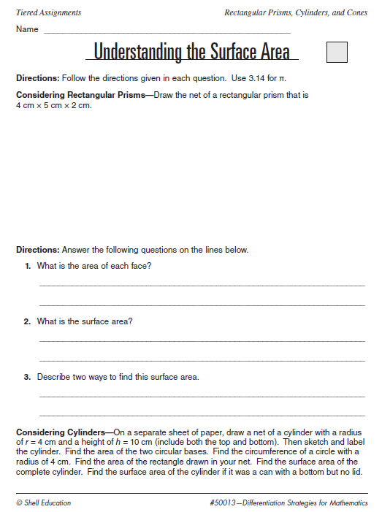
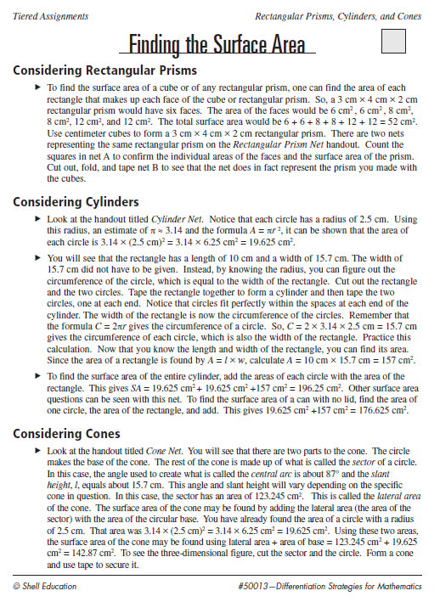
On Grade Level
Calculator
30 or more cm cubes
Scissors and Tape
finding.pdf
undrstndS.pdf
nets.pdf

Slide 70
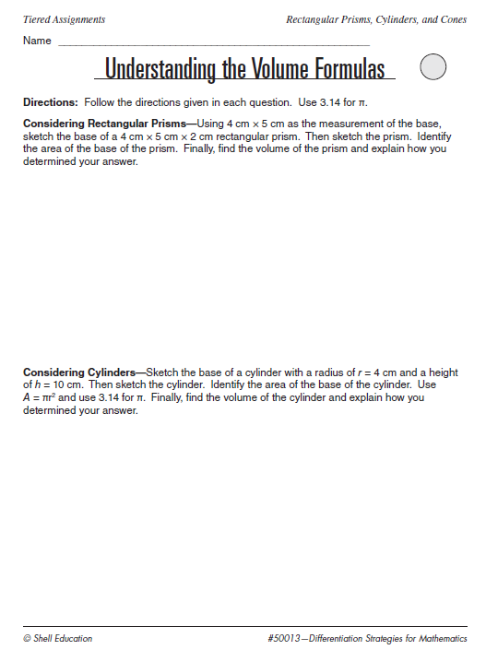
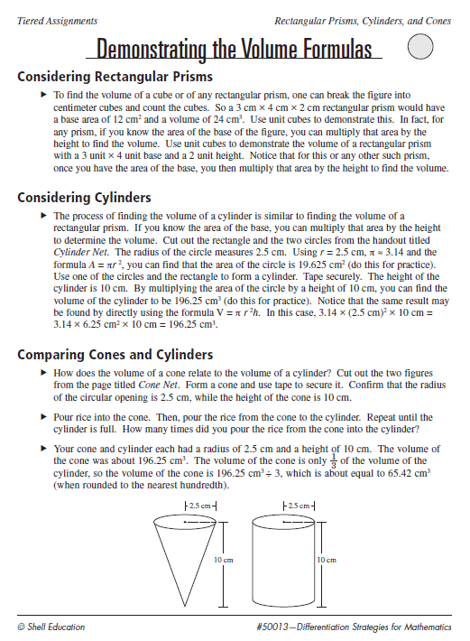
Below Grade Level
Teacher Support
Calculator
30 or more cm cubes
Scissors and Tape
Uncooked rice
demnstrte.pdf
undrstndV.pdf
nets.pdf

Slide 71
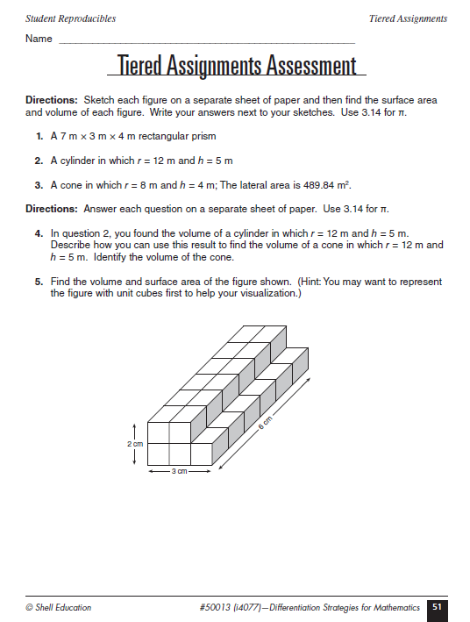
Tiered Assignment Assessment
Page051.pdf

Slide 72
Applying Dilations Grades 9-12
What is the goal or the standard being addressed?
Dilations about the origin
What do all students do?
Discuss and explore dilation and scale
Work with images and dilations
Possible Anchor Activities
Have several pictures and transparent grids available
Students use the grids to find the coordinates of points on the picture and use them to create enlarged or shrunken images
Explore what happens if different scales are used for x and y

Slide 73
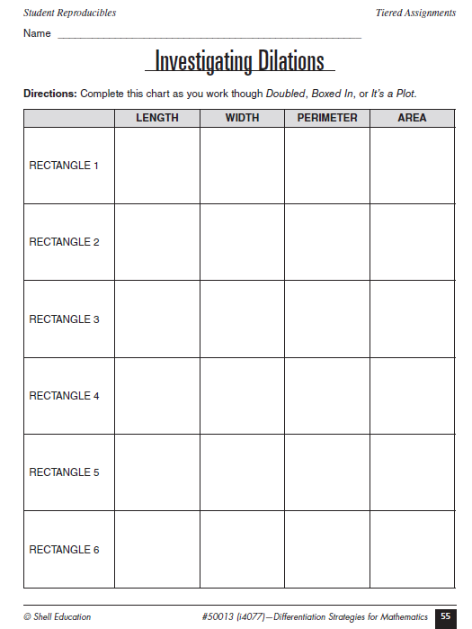
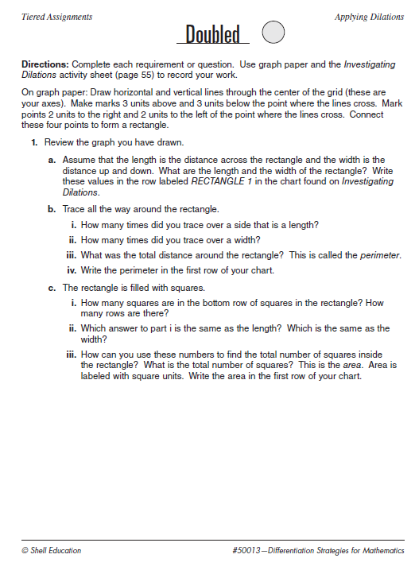
Applying Dilations Grades 9-12 Below Grade Level
Graph Paper
Rulers
Doubled.pdf
Page055.pdf
Create dilated figures and investigate

Slide 74
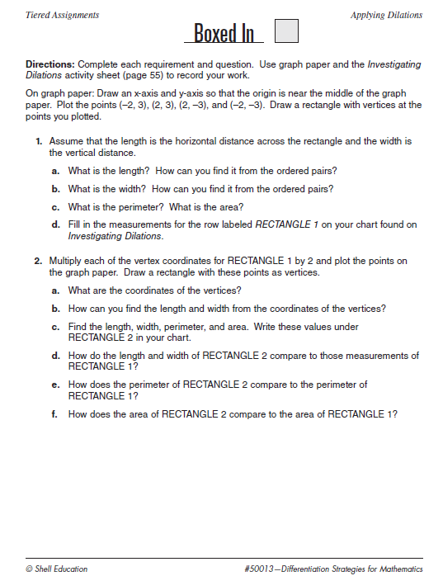
Applying Dilations Grades 9-12 On Grade Level
Graph Paper
Rulers
boxed.pdf
Page055.pdf
Create dilated figures and investigate

Slide 75
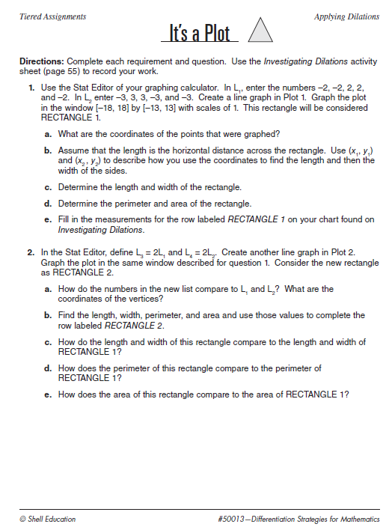
Applying Dilations Grades 9-12 Above Grade Level
Graphing Calculator
plot.pdf
Page055.pdf
Create dilated figures and investigate

Slide 76
Applying Dilations Grades 9-12
Closure
Regroup so that there are at least two students from each of the previous groups included in the new groups
Whole class discussion on dilation, scale, how scale relates to changes in perimeter and area
Connect scale factors such as 0.8 and how they could be used to multiply by a fraction

Slide 77
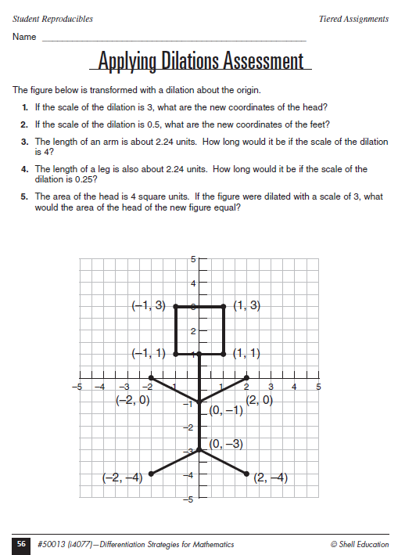
Applying Dilations Grades 9-12
Assessment
Page056.pdf

Slide 78
Leveled Questions

Slide 79
Leveling Questions?
Adjusting the language of a question to the different levels of student readiness
Useful in small group, homogeneous settings (small groups or assignments)

Slide 80
Depth of Knowledge

Slide 82
Leveling Questions: Gifted, High Achieving
May already know the answers to questions
May need less repetition to learn
Consider sentence/question stems to create challenging questions
How many ways can you create/solve…?
What would happen if…?
Defend the best use of/strategy for…?
Evaluate your ideas for…?
Debate…
How can you improve…?
What is the likelihood...?
What are three ways to…?
Propose a solution/strategy to…?

Slide 83
General Steps for Using Leveled Questions to Differentiate
Start with the whole class topic (on grade level question)
Open Up the Question
Narrow down the question
Add context to the language
6+ ? = 10
Jon has 6 puppies. He wants to have 10 puppies. How many more puppies does he need to buy?
? =
John has 6 puppies .
He wants 10 puppies .
How many more puppies does he need to buy?

Slide 84
K-2 Example: What’s Missing?
Overview
Students observe as the teacher takes an unknown number of objects from a total group of counted objects. The students then figure out the number of missing objects.
Students work in pairs to hide an unknown number of objects from a known total to design problems with missing addends.
Students work in groups based on proficiency to answer leveled questions about on their skills to reinforce and extend knowledge about missing addends.

Slide 85
K-2 Example: What’s Missing?
Benefits of Leveled Questions
Above Grade Level Students: Engages critical and creative thinking
On Grade Level Students: Analyze problems
Struggling Students: Shows there is room for growth and development
English Language Learners: Show mathematical thinking with supports

Slide 86
K-2 Example: What’s Missing?
Whole Class Activity
Count out 10 chips and drop them into an empty paper bag
Take out some chips (for example 6) and put them somewhere visible (on the board, under a document camera) and count them. Explain if you take the 6 chips you pulled and added the ones in the bag you would have 10 chips.
Elicit what the number sentence would be and write it on the board? 6 + ? = 10 What we are finding is the addend- a number that is added in an addition problem Have students figure out the answer
Show students what is left in the bag and write in the missing addend (4)
Count the ones left in the bag to see if the answer is correct (you may want to repeat this with different missing addends)
Once students are comfortable, move to pairs- give each pair a number of chips and a bag (the number of chips can vary or be the same)- have students write their number sentences

Slide 87
K-2 Example: What’s Missing?
Whole Class Activity (continued)
Have several pairs share how some of their number sentences
Students will now complete special activities about missing numbers File page063.pdf
Above Grade Level: Page 63 (triangle)
On Grade Level: Page 64 (square)
Below Grade Level: Page 65 (circle)

Slide 88
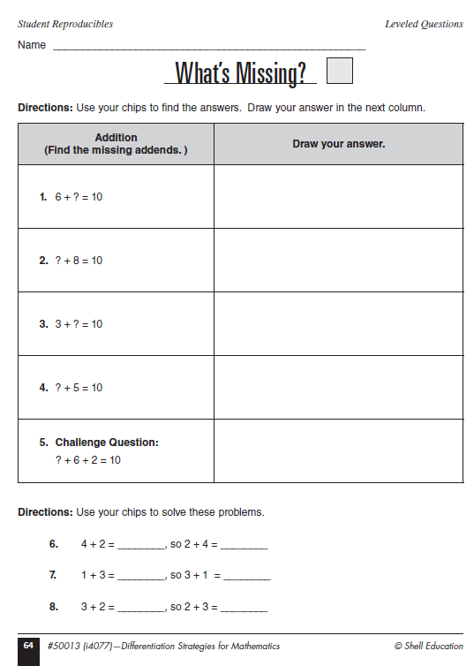
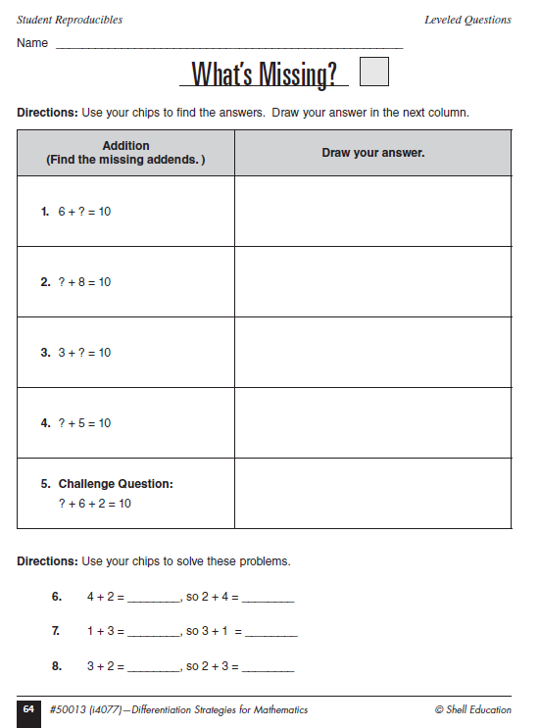
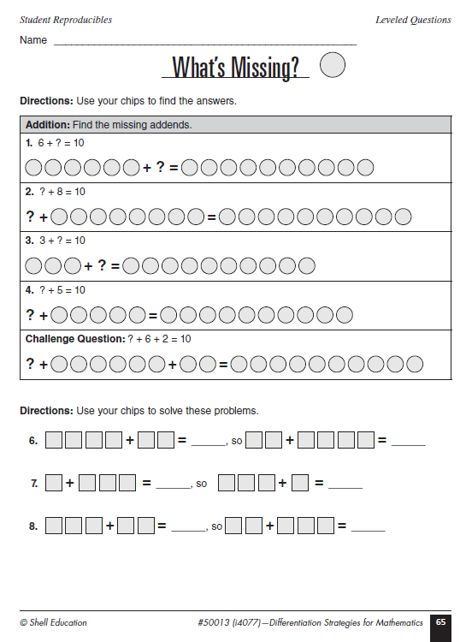

Slide 89
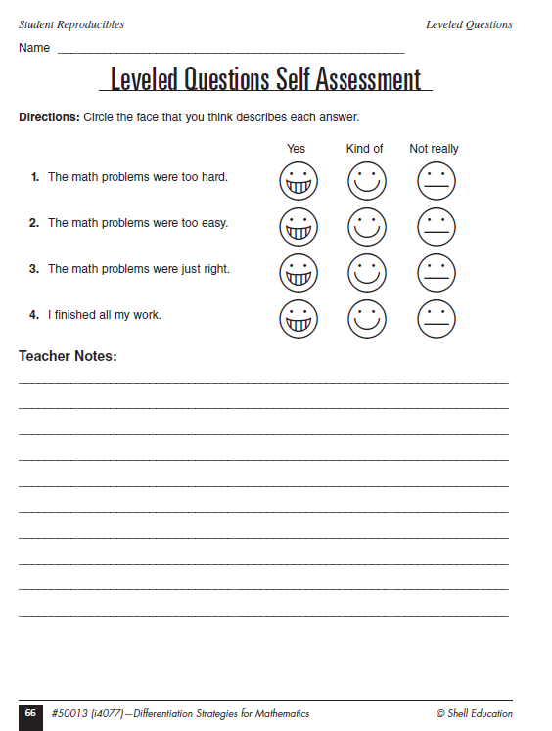
K-2 Example: What’s Missing? Anchor Activities
Remember: One Key to Successful Differentiation: Anchor Activities
Students who complete work early can create their own story problems with missing addends and minuends
Student who complete work early can contribute to a class challenge book by writing their own story problems that involves finding the addend
Other Ideas?
Page066.pdf

Slide 90
3-5 Example: Word Variables (Unknowns)
Overview
Students will be introduced to an equation with variables (unknowns) They will learn that a letter can be used to represent a number in an equation They will learn to solve equations containing variables by substitutions
Students will create their own equations with variables (unknowns) Pairs will work together to figure out what the other one has done and solve simple algebraic equations
Students will work with leveled questions
Learning Standards
Demonstrate an understanding that a variable (unknown) is a letter or symbol that stands for one or more numbers
Solve open sentences involving operations on whole numbers

Slide 91
3-5 Example: Word Variables (Unknowns)
Whole Class Activity
Write a + b = ? where all students can see it
Ask students if they can find “the” answer to this problem
Then write a=5 and b=3 on the board
Ask students if they can solve the equation now
You may need to write 5 + 3 = ?
Share that a and b stand for “secret” or unknown numbers Any letters can be used as variables
Repeat this activity with c – d = ? Write c=12 and d=4 on the board Have students write the equation (12-4=?) and solve
Ask students to write some of their own problems Have them share problems with partners to solve
Meet again as a class and share some of the equations created
Explain that students will be working on activity sheets

Slide 92
3-5 Example: Word Variables (Unknowns)
File (page69.pdf)
Above Grade Level Page 69 (triangle)
On Grade Level Page70 (square)
Below Grade Level Page71 (circle)

Slide 93
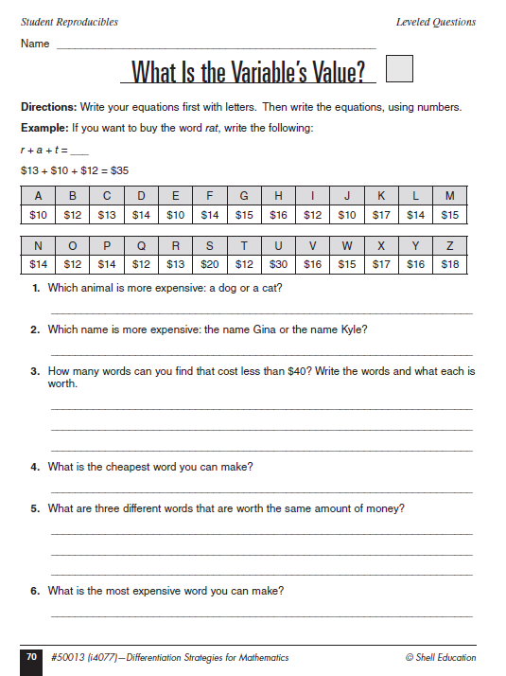
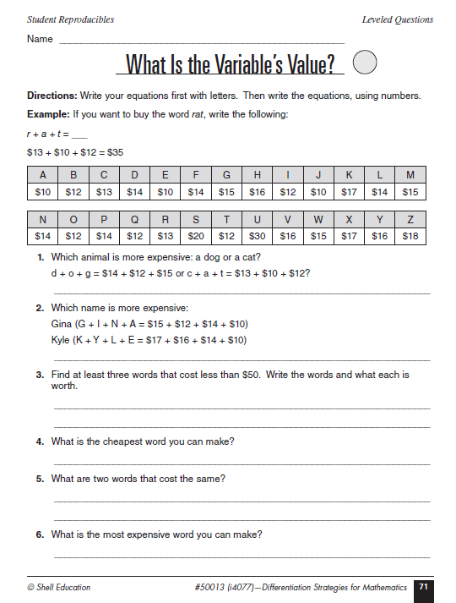

Slide 94
Assessment

Slide 95
6-8 Example: Discovering Variables
Overview
Brief discussion about order of operations, variables, and simplification
Whole class review on combining terms
Students will use their knowledge of combining like terms to create problems of their own
Learning Standards
Simplifying standards by combining like terms and will use order of operations
Understanding the basic concept of a function

Slide 96
6-8 Example: Discovering Variables
Whole Class Activity
Review concept of variable, steps involved in following the order of operations, and the role of simplifying
Place students into homogeneous groups based on ability levels
Each group will have its own task
Below Level: Discovery Card A page 75 and Recording Sheet (record1.pdf) (circle)
On Grade Level: Discovery Card B page 76 and Recording Sheet (record2.pdf) (triangle)
Above Grade Level: Discover Card C page 77 and Recording Sheet (record3.pdf) (square)
Anchor Activity
Who Has (page 78) Create I have, who has problems

Slide 97
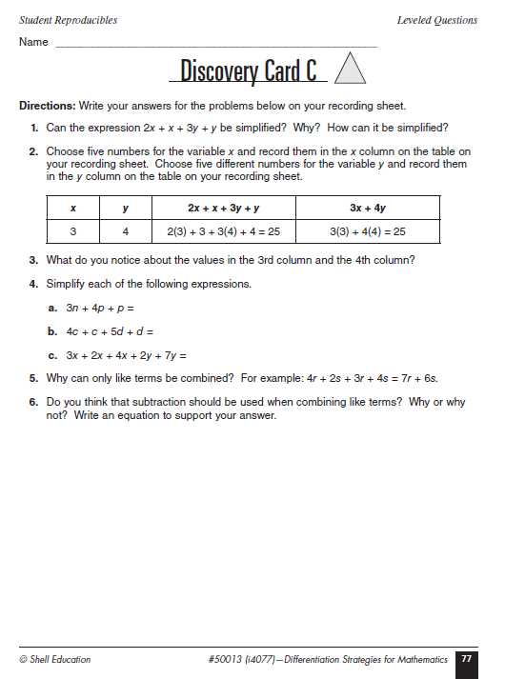
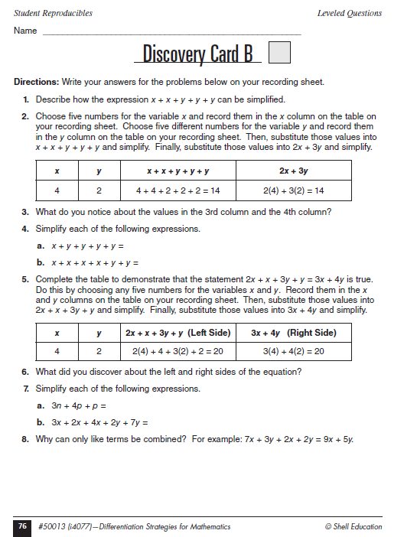

Slide 98
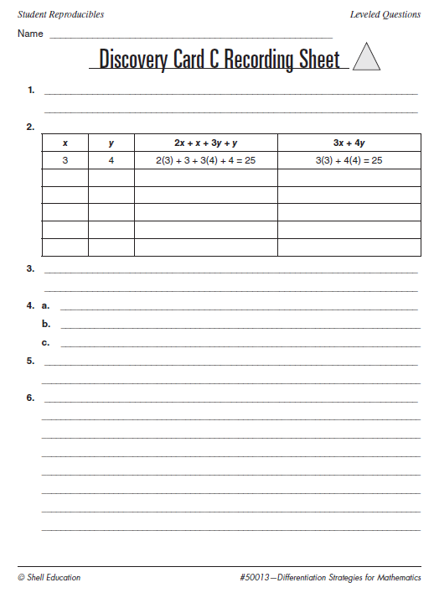
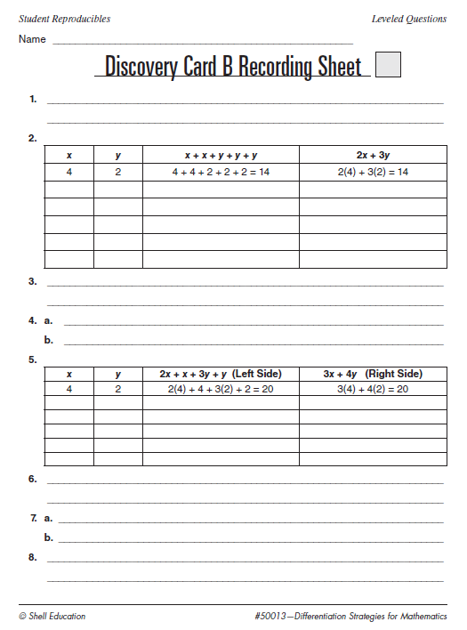

Slide 99
Anchor Activity

Slide 100
9-12 Example: Multiplication of Binomials
Overview
The use of algebra tiles, the vertical method, and the use of the mnemonic FOIL to multiply binomials will be demonstrated and explained
Each student will practice multiplying binomials and will have this varied by his/her readiness

Slide 101
9-12 Example: Multiplication of Binomials
Whole Class Activity
Review the distributive property by having student simplify $2(3x^{2} −4x+5)$
Make sure that the concept of distribution and the distributive property is understood
Review the process with and without algebra tiles (ensuring that the concrete understanding is there is important) Remember shaded tiles are negative and
Explain that student will learn to multiply binomials of the form (ax+b)(cx+d), where a,b,c, and d may be positive or negative

Slide 102
9-12 Example: Multiplication of Binomials
Whole Class Activity (continued)
Show students how to determine the product of $\left(x−3\right)\left(2x+1\right)$ by using algebra tiles
Glencoe: http://www.glencoe.com/sites/common_assets/mathematics/ebook_assets/vmf/VMF-Interface.html
Illuminations: http://illuminations.nctm.org/activity.aspx?id=3482
Ask questions such as:
Explain the meaning of $x^{2}, −x^{2}, x, −x, 1 and −1$ tiles
How did we know how many x and –x tiles to use?
Remembering that $x+−x=0$ how many of each kind of tile are left after you combine opposites?
What is the product in simplified form?
Have heterogeneous groups simplify $\left(2x−5\right)\left(x+3\right)$
They should take turns arranging tiles

Slide 103
9-12 Example: Multiplication of Binomials
Whole Class Activity (continued)
Once students are comfortable with the concrete algebra tiles, show them the vertical method by using that method to find the product of $\left(x−3\right)\left(2x+1\right)$
Ask questions such as:
What was multiplied together to get $2x^{2}−6x and x−3$?
Why is the -6x lined up under the x?
What is the product in simplified form?
Explain how each step corresponds to the steps in the algebra tile method
Have heterogeneous groups simplify $\left(x−4\right)\left(x−2\right)and (2x−5)(x+3)$

Slide 104
9-12 Example: Multiplication of Binomials
Whole Class Activity (continued)
Connecting the Concrete, the vertical method, and a mneumonic (FOIL)
Ensure students have a good grasp before introducing FOIL- make sure students connect that foil is the distributive property and that they have used it for years $12∗34=\left(10∗10\right)+\left(10∗4\right)+\left(2∗30\right)+\left(2∗4\right)$
Explain how FOIL makes remembering the steps for distributing possible
$$(x−3)(2x+1)$$
What is the sum of the First, The Outer, The Inner, and the Last terms
What is the product in simplified form?
Have heterogeneous groups simplify $\left(x−4\right)\left(x−2\right)and (2x−5)(x+3)$

Slide 105
9-12 Example: Multiplication of Binomials
Whole Class Activity (continued)
Review and compare the three methods (note this may need to occur over time based on student readiness)
Differentiated Work
Assign each student a task (circle, square, triangle) based on readiness File: Investigating Binomial Multiplication (page083.pdf)
Circle: Asks students questions mostly at knowledge, comprehension, and application levels
Square: Asks students questions mostly at the application and analysis
Triangle: Asks students questions mostly at the analysis, synthesis, and evaluation levels
Response Sheet for All Students: binomial.pdf Homogeneous groups are best

Slide 106
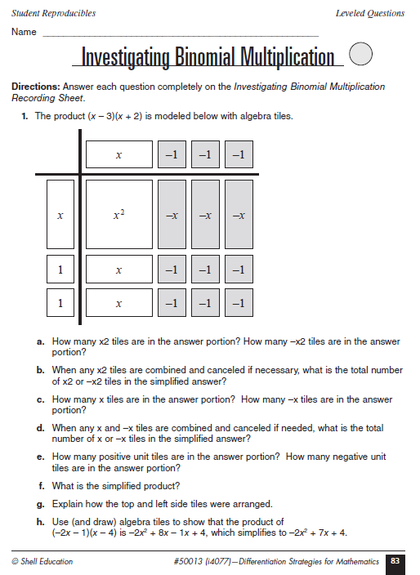
Circle (Below)

Slide 107
Square: On Grade Level

Slide 108
Triangle: Above Grade Level

Slide 109
Student Recording Sheet

Slide 110
Multiple Intelligences
https://storify.com/hessbe/improved-learning-through-multiple-intelligence

Slide 111
K-2 Example: Making a Good Guess
Overview of the Activity
Students will estimate how many goldfish crackers are in a jar
Students will estimate the distance between themselves and an object in the classroom
Students will choose individual activities based on Multiple Intelligences

Slide 112
K-2 Example: Making a Good Guess
Whole Class Activity
Fill a small jar or bag with goldfish crackers. Explain that you would like to share with everyone, but you are not sure you have enough.
Discuss how many people are in the class and put that number of crackers in an identical container.
After comparing the two jars make sure everyone understands that the second jar represents each person getting one cracker.
Have each student make an estimate about how many crackers they think are in the first jar. Record these estimates on a chart paper
Count the goldfish in the first jar (by 1s, 5s, or 10s)
Introduce some terms when comparing (more than, less than, closest to, furthest from)
Ask which of the student estimates was closest to the actual, which was farthest from the actual

Slide 113
K-2 Example: Making a Good Guess
Whole Class Activity (continued)
Place a piece of tape on the floor. Ask students to stand at the piece of tape and estimate how many steps it would take to get from that tape line to an object in the room. (Heel to toe steps)
Have students step off their estimate
Ask students to name the student who is closest to the object and who is farthest away
Ask how many more steps it would take to reach the object
Hand out activity sheets (pages 95-97)
Explain that students will choose the activity they are most interested in

Slide 114
K-2 Example: Making a Good Guess

Slide 115
K-2 Example: Making a Good Guess Assessment

Slide 116
3-5 Example: Three Minute Shopping Spree
Overview
Learn about rounding before they participate in a three-minute shopping spree
They will work to figure out how they can spend the closest to $25
Students will watch a demo of estimating the whole by estimating the parts.
Students will get to complete activities based on multiple intelligences

Slide 117
3-5 Example: Three Minute Shopping Spree
Whole Class Activity
Tell students that they will be working in pairs on a three-minute shopping-spree contest
They will not have time to add up the prices, but will have to estimate the costs
The group that spends the closest to $25 without going over will be the winners
Explain that first, the class is going to be given a strategy for estimating
Ask what do students know about rounding numbers
Big idea- rounding helps us work with numbers mentally
Round number that ne in 1 through 4 to the next lower number that ends in 0
For example 94 would round to 90
Numbers that end in 5 through 9 should be rounded up to the next even ten
For example, 68 would be rounded to 70
You may want to use a number line to explore why these are good guidelines

Slide 118
3-5 Example: Three Minute Shopping Spree
Whole Class Activity (continued)
Give students copies of the Three Minute Shopping Spree List Order Form (page101.pdf)
Have students check off the items they are going to buy (only given three minutes and a goal of $25)
Have students add the prices
The students who got the closest to $25 without going over win
Discuss strategies used in student estimations
Look for similarities and reasons for accuracy

Slide 119
3-5 Example: Three Minute Shopping Spree
Share Activities (page102.pdf; page103.pdf; page104.pdf)
Students choose one to complete

Slide 120
6-8 Example: The Great Jelly Bean Estimation
Overview
This lesson emphasizes how to offer four different multiple intelligence activities within one lesson (bodily kinesthetic, visual/spatial, interpersonal, and logical mathematical)
These could take 2-3 class periods to complete
One activity will be completed by each student and then students choose a second activity from a list
Students can be in groups of three
Standards
Consider the volume of rectangular prisms to aid in estimation
Gather, analyze, and display data from a sample

Slide 121
6-8 Example: The Great Jelly Bean Estimation
Whole Class Activity
Students in groups of three
Each group will need tape, scissors, a copy of Candy Prism Net (candy.pdf), and jelly beans
Give each student a copy of The Candy Dispenser (page108.pdf)
Read the instructions and provide time for students to work

Slide 122
6-8 Example: The Great Jelly Bean Estimation

Slide 123
6-8 Example: The Great Jelly Bean Estimation
Keep students in groups of three
Give each student a copy of the Jelly Bean Project (page109.pdf) and ask them to read the assignment
Explain that each student will be assigned one section of the project to complete
Point out that some of the work for the Jelly Bean Project activity sheet depends on the results from The Candy Dispenser activity

Slide 124
6-8 Example: The Great Jelly Bean Estimation

Slide 125
6-8 Example: The Great Jelly Bean Estimation
The student responsible for gathering survey responses will need to do so before the next class period
Set a minimum number of responses
There is a space on the Jelly Bean Project to record your requirement
You may need to provide your students with the number of students in the school an the number of weeks in a school year
On the first day groups will discuss individual assignments, how information will be collected, and how information will be presented
On the second and third day, groups will complete the project
Have students share results when complete

Slide 126
6-8 Example: The Great Jelly Bean Estimation
Assessment
Have students complete the assessment “Group Project Planner and Assessment (page110.pdf)
The first portion is meant to be completed as the students work together
The second part is to be completed after they have shared with one another

Slide 127
6-8 Example: The Great Jelly Bean Estimation
Assessment (continued)
Have each student answer the questions below
If 5 beans fit into a 1-inch by 1-inch square, how many beans will fit into a 4-inch by 4-inch square?
If 20 beans fit into a 1-inch by 1-inch by 1-inch cube, about how many beans would fit into a rectangular prism measuring 4-inches by 4-inches by 6 inches

Slide 128
9-12 Example: Modeling Linear Behavior
Overview
Students will investigate velocity on the slope of a time-distance graph and learning the meaning of increasing and decreasing functions
Student volunteers will move according to teacher directions while using a motion detector to record their motion. Student volunteers will match calculator-generated graphs. The class will analyze the motion
Learning Standards
Students will use mathematical models to represent and understand quantitative relationships
Students will analyze functions by investigating rates of change, intercepts, and zeroes.

Slide 129
9-12 Example: Modeling Linear Behavior
Whole Class Activity
Discuss the meaning of rate as comparison
Common vocabulary- per
Common situations- gas mileage, speed, hourly wages
Introducing students to a motion detector
Do some simple experimentation with the motion detector Vernier Activity (http://www2.vernier.com/sample_labs/MSV-33-COMP-graphing_motion.pdf)
Example of Motion Detector http://www.vernier.com/training/videos/play/?video=113
Have students walk toward and away from the wall, speeding up and slowing down (or stand still)
Have the class discuss how the time-distance graph describes the motion
By looking at the graph, the students need to be able to tell when the distance between the wall and the walker is increasing, decreasing, or constant
When Velocity is positive and negative
Students need to be able to describe the starting location as the y-intercept on the graph

Slide 130
9-12 Example: Modeling Linear Behavior
Whole Class Activity (continued)
Have volunteers walk with the motion detector to match generated graphs
Before the walker begins, , ask the class to describe the strategy for each walk (where to start, how to walk, etc.)
Have pairs work on Part I of the “Out Walking” activity sheet (page114.pdf)
When students complete Part I of the activity, discuss the relationship between the slope of each segment of the graph and the speed the walker was moving
Examine negative slope and relate it to decreasing distance
Discuss the difference between speed and velocity

Slide 131
9-12 Example: Modeling Linear Behavior

Slide 132
9-12 Example: Modeling Linear Behavior
Whole Class Activity Continued
Draw a graph in which the walker would first move with a velocity of -0.667 ft/sec and then change to a velocity of 0 ft/sec, move slowly with a velocity of 0.2 ft/sec, and finally move quickly with a velocity of 0.75 ft/sec
Ask students to explain each section in terms of the motion (closer, slower, etc.)
Have students complete part II of the Out Walking Activity (page114.pdf - continued)

Slide 133
9-12 Example: Modeling Linear Behavior

Slide 134
9-12 Example: Modeling Linear Behavior
Assessment
Give students a graph and ask students to describe the motion of the walker and find the velocity for each line segment in the graph
Give students a scenario and have them complete the graph using graph paper
Draw a graph showing that someone starts at a distance of 5 feet from the wall and walks with a velocity of -0.5 ft/sec for four seconds, with a velocity of 0 ft/sec for two seconds, and then with a velocity of -0.333 ft/sec for six seconds. Then, describe the motion of the walker considering details such as being closer to and farther away from the wall, starting and stopping, and moving faster and slower.

Slide 135
Most Difficult First
Share the most difficult task or problem(s)
Students who can demonstrate precision and accuracy do not need the additional practice

Slide 136
Choice and Menus
The Power of Choice
Choice:
Preferred Learning Styles of Gifted Kids
Choice only option that allows a teacher to meet a variety of student needs
Greater sense of independence
Increased Focus
Greater Completion Rates
Kids and People do not always know what they want
Also available for Language Arts, Science, Social Studies and for Inclusive Classrooms
https://www.ted.com/talks/malcolm_gladwell_on_spaghetti_sauce
Notes:
Video at 10:00 minutes to 12:30 ish- people do not know what they want

Slide 137
Tic-Tac-Toe Menu (Choice Menu One)
Characteristics
Eight Choices
One Free Space
Same Level of Bloom’s
Same Weight for Grading
Flexible
Can be limiting for students

Slide 138
Check List (List Menu) (Choice Menu Two)
Characteristics
Challenge List
At least 10 Predetermined Choices
Weighted Scoring
Based on Bloom’s
Responsibility
Few Topics
No guarantees

Slide 139
2 -5 - 8 Menu (Choice Menu Three)
Characteristics
Two Choices (2 points)
Four Choices (5 points)
Two Choices (8 points)
Based on Bloom’s
Generally limited to one topic
Set Point Value/Target
Source: https://teacherleaders.wordpress.com/2014/06/28/standards-based-choice-assessment/

Slide 140
Baseball Menu (Choice Menu Four)
Characteristics
At Least 20 Choices
Singles (understand)
Doubles (apply and analyze)
Triples (evaluate)
Home Run (create)
Earn a certain number of runs for 100%

Slide 141
Math Success Mindset
Thinking first…Developing an “I can” mindset
Replace ‘buts’ with ‘and’ and move from complaints to solutions…
I’d like to do my homework, but I don’t have time.
I’d like to do my homework, and I don’t have time, so I will…
I’d like to do better in math, but I like science more.
I’d like to do better in math, and I like science, so I will…
I want to differentiate math, but…
I want to differentiate math, and… so I will…

Slide 142
Credits
Wendy Conklin, Differentiation Strategies for Mathematics ISBN-10: 1425800130; ISBN-13: 978-1425800130 (2009)
Laurie Westphal, Differentiating Instruction with Menus: Math (Grades 3-5) ISBN-10: 1593632266; ISBN-13: 978-1593632267 (2007)

Slide 143
Thank You
Michael Elder
Academic Innovation and Gifted Services
Onslow County Schools Michael.elder@onslow.k12.nc.us

Slide 144
Other Digital Tools
Thanks to Shari Richardson (retired: Onslow County)
http://www.livebinders.com/play/play?id=1643410
Math Playground (especially Thinking Blocks)
http://www.mathplayground.com/thinkingblocks.html
Quantiles (shared earlier)
https://quantiles.com/tools/quantile-teacher-assistant/
Gifted Links Compiled Symbaloos
http://onslowaig.weebly.com/gifted-links-symbaloo.html
Today’s Presentation and Past Presentations:
http://onslowaig.weebly.com/gifted-conference-presentations.html

