Slide 1
Odyssey of the Mind
Virtual Overview for 2017-2018
Michael Elder
Onslow County Schools
Career and College Readiness
September 12, 2017

Slide 2
Onslow
M
Coaches Training:
Sat., Nov. 4 Queens Creek Elementary
2: Emoji, Speak for Yourself
1: Triathlon Travels
3. Mockumentary, Seriously?
Time to Get OM Rolling for 2016-2017!
If you are new, WELCOME! If you are returning, THANKS!
OM is a chance to celebrate creativity, teamwork, and student-leadership. It takes a special person to coach OM, so we are thankful for each of you.
On Monday, September 18th, we will have an online Skype Meeting. Join with this link: http://bit.ly/OM2017coaches1 (this will be recorded if you are not able to attend).
Each coach must complete our Onslow County OM Microsoft Form (http://bit.ly/OMTeam1718) by Friday, September 29th. This way we will be able to submit for payment and get packets as quickly as possible. The district will only pay the application fee for registrations received by September 29th.
Judges Training: TBD
Swansboro HS & or Queens Creek Elementary
Coastal Region Tournament Saturday, February 24, 2018
QCE and Swansboro HS
http://ncom-coastal.org/
4. Animal House
5. A Stellar Hangout
Primary Problem: We’re Cooking Now

Slide 3
Onslow
M
Coaches Training:
Sat., Nov. 4 Queens Creek Elementary
Time to Get OM Rolling for 2017-2018!
Payments and Deadlines
MICROSOFT FORM LINK (http://bit.ly/OMTeam1718) DUE September 29 for district to pay: OM Registration: $100 Fee Coaches Training (November 4th): $20
2) NC-Coastal Tournament Registration $100
Each Coach Needs to Register Online (http://ncom-coastal.org) by December 1 (only need one player name and judges name- if you have all the names and your volunteer, that is even better)
In order for the district to pay, forms must be completed by deadlines shared above.
Judges Training: TBD
Swansboro HS & or Queens Creek Elementary
Coastal Region Tournament - Saturday, February 24, 2018
QCE and Swansboro HS
http://ncom-coastal.org/
NCOM State Tournament Saturday, March 29, 2018
Wingate University
OM World Finals May 2018 (TBA)
Iowa State University
Ames, Iowa

Slide 4
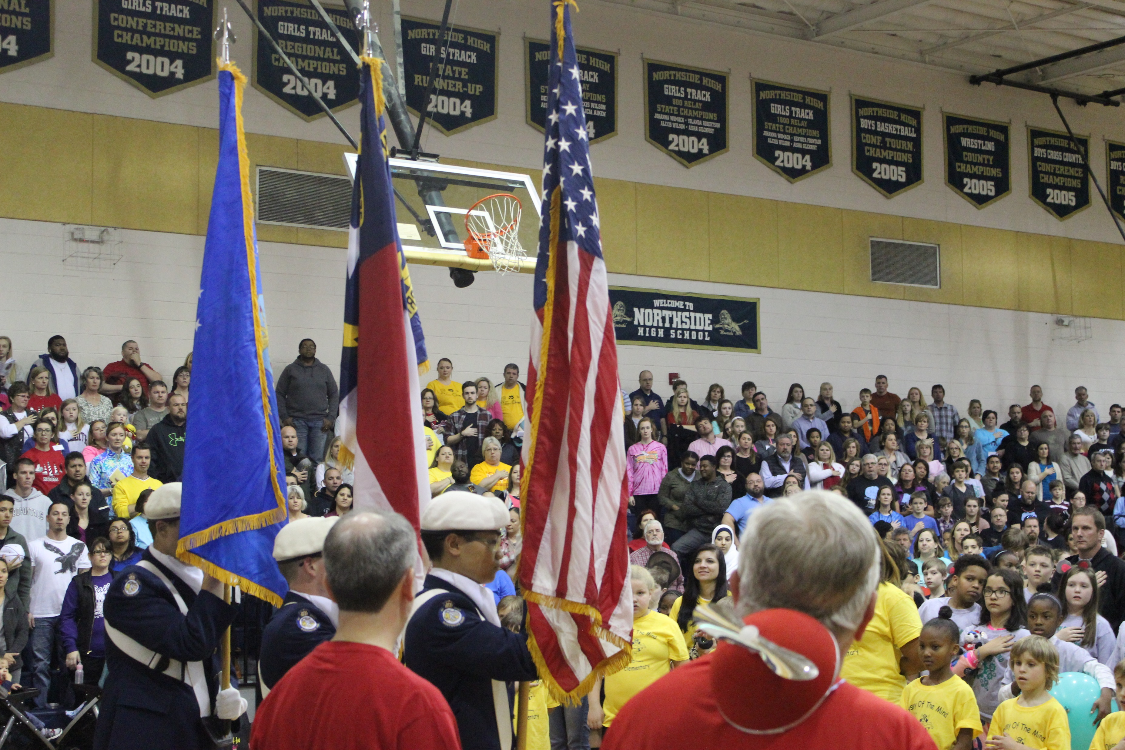
Coaches’ Training
Saturday, November 4
Location Being Finalized
Most likely Swansboro High School or Queens Creek Elementary
Generally 8:30-3:00 (exact times will be emailed)
If you’ve coached before…
If you’ve not coached before…
What you’ll get

Slide 5
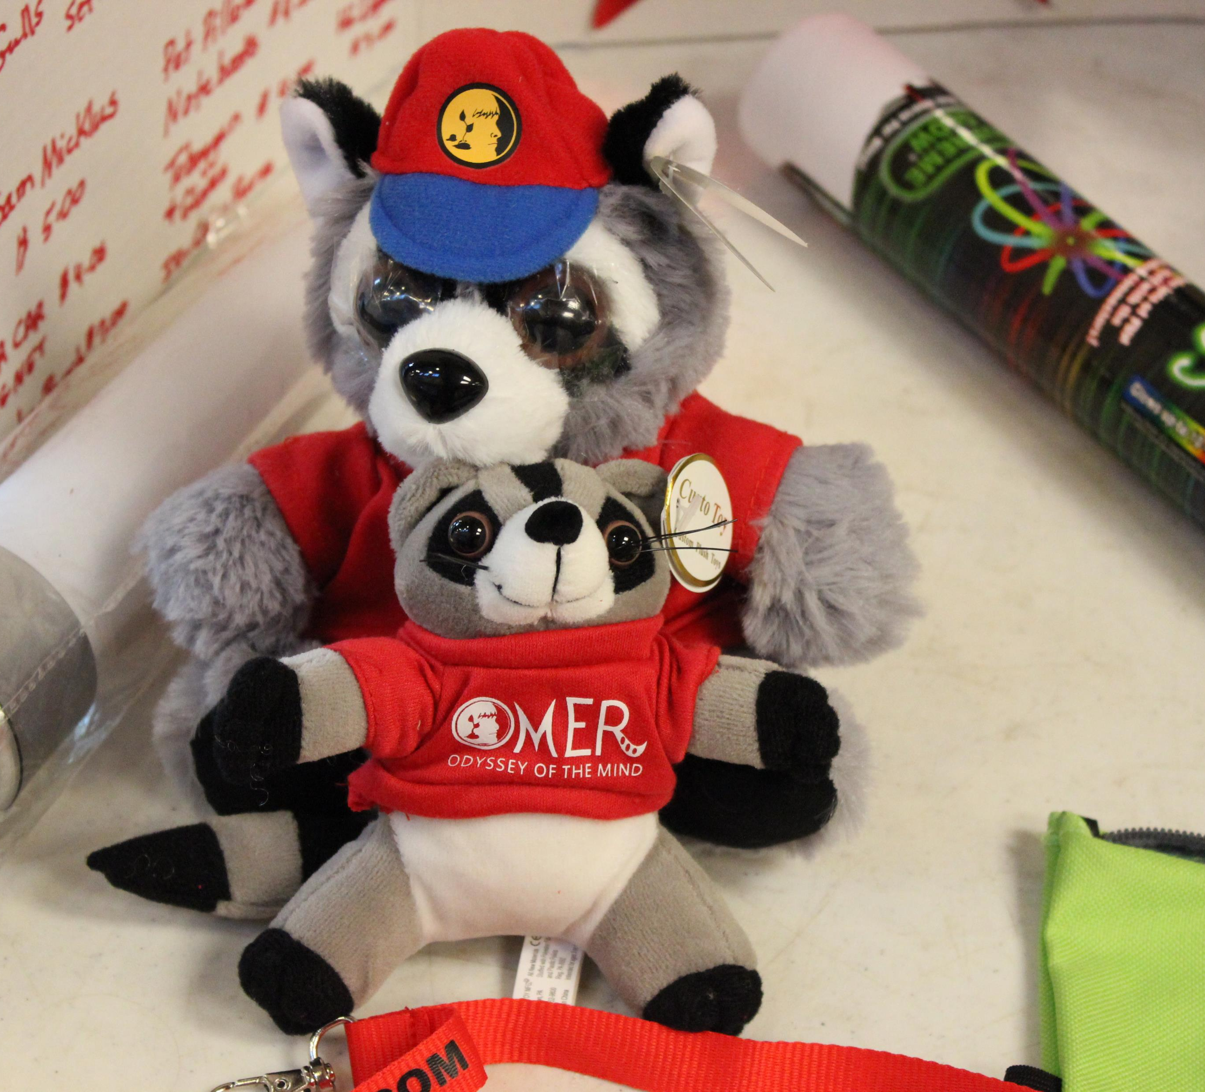
Judges and Volunteers
Each Team must furnish one Judge for the tournament
Serves all day
Must be willing to come to training or be trained
Each team must furnish one Volunteer for the tournament
Serves 2-3 hours

Slide 6
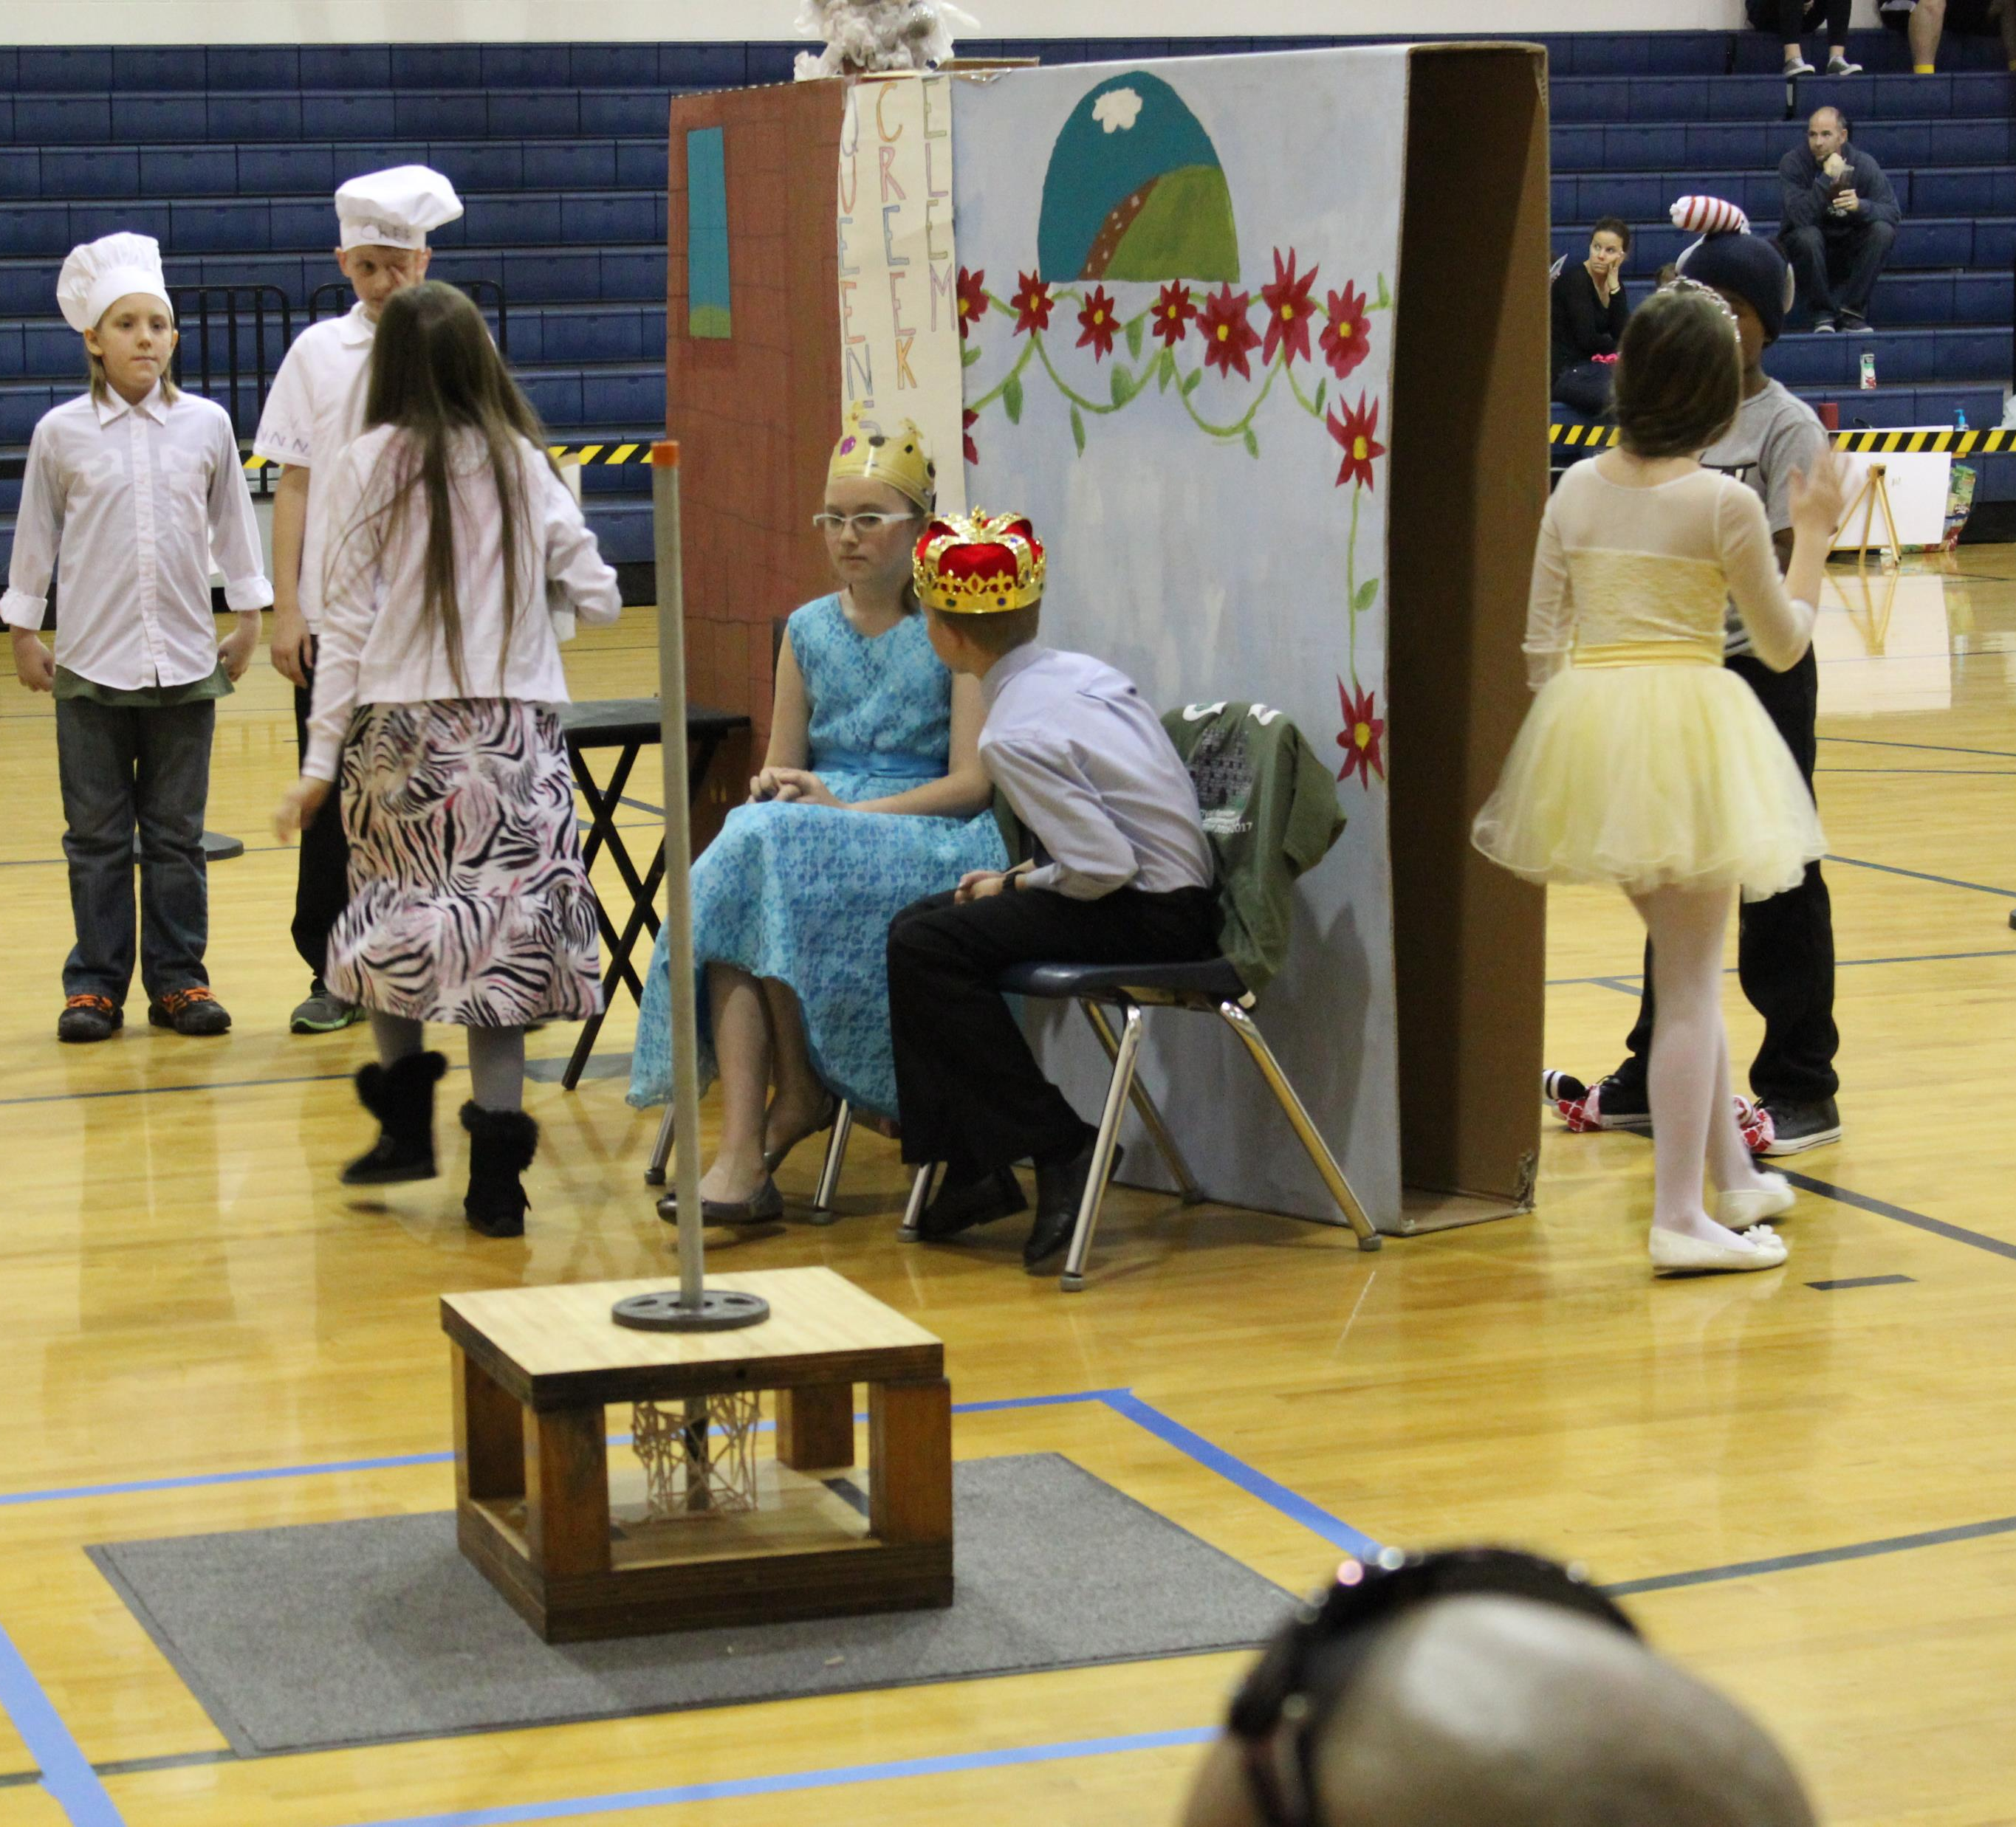
Coaching
7 Minds, 14 Hands
Coach as a Resource
Read your problem
Read your role as coach
Let the students do the planning and thinking

Slide 7
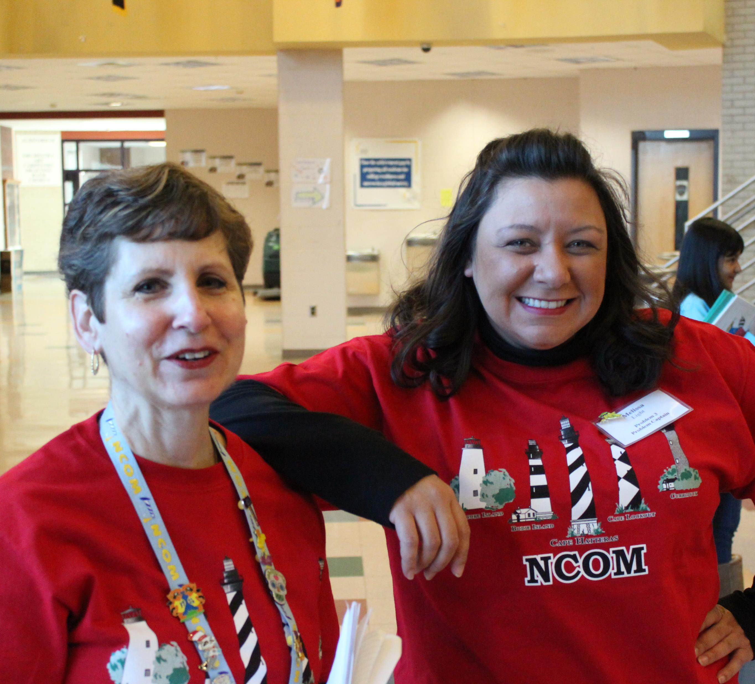
Resources
Onslow County Schools OM Site
http://onslowaig.weebly.com/odyssey-of-the-mind.html
Coastal NC OM Site
http://www.ncom-coastal.org/
International OM Site
https://www.odysseyofthemind.com/p/
2017-2018 Problem Synopsis
https://www.odysseyofthemind.com/p/2018-long-term-problem-synopsis/
Full problem descriptions come at coaches’ training and when you register

Slide 8
Next Steps
Watch this Overview ☺
Complete the Initial Sign up (http://bit.ly/OMTeam1718 )
by September 29th
Join our Skype Q & A Session on Monday, September 18
http://bit.ly/OM2017coaches1
Sign up for Coaches’ Training (http://www.ncom-coastal.org/)
As soon as link is available
Begin selecting and working with your team
Register for the Coastal Tournament (http://www.ncom-coastal.org/)
By December 1
This includes knowing your judge and volunteer (and at least one team member)
Updates will come through email and be posted to our website

Slide 9
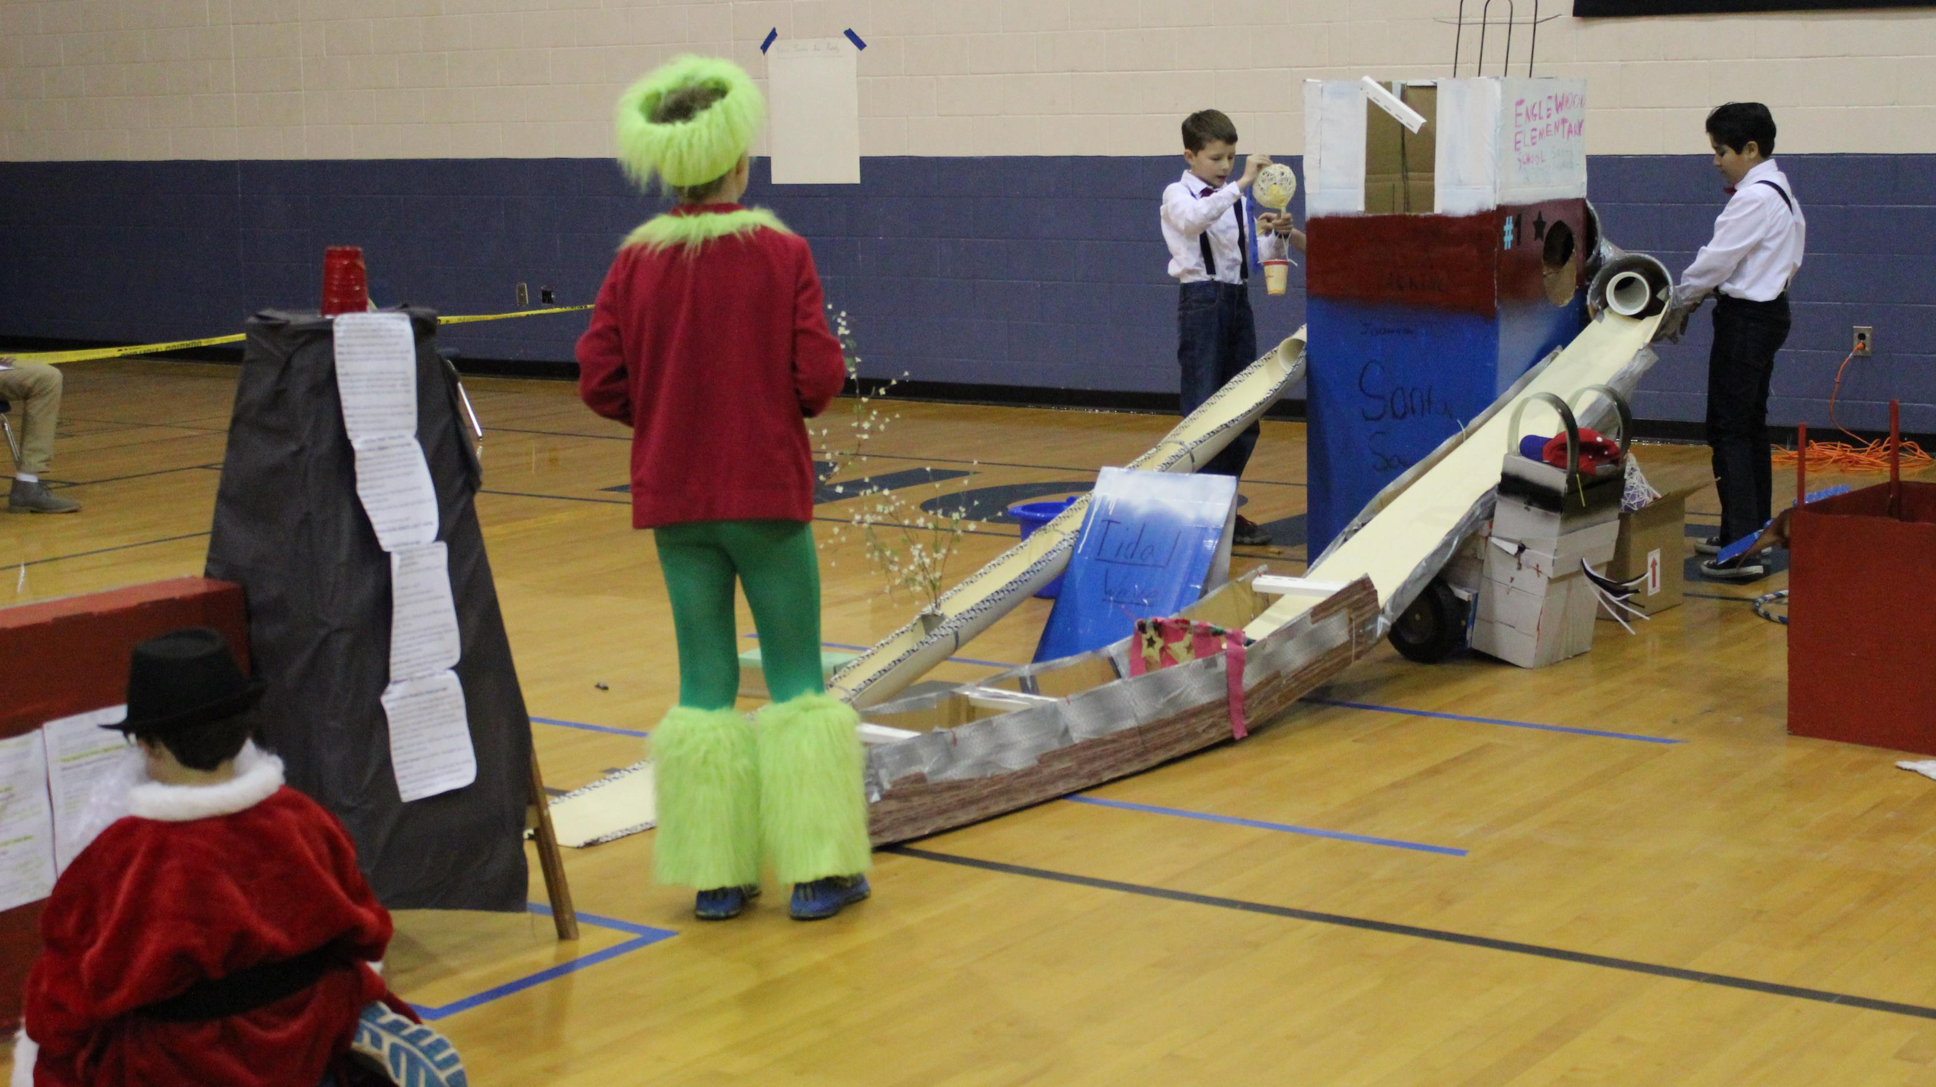
Contact Information
Michael Elder
Michael.elder@onslow.k12.nc.us
(910) 455-2211 ext. 20264
Pam Brewer
Pam.brewer@onslow.k12.nc.us
(910) 455-2211 ext. 20261

